Slide 1
Hashemite Kingdom of Jordan – Royal Medical Services Managing the medical implications of human catastrophe Jordan’s Global Peace Delegates Syrian Refugees Crisis
Director General of the Royal Medical Services
Major General Dr . Khalaf Al-Jader

Slide 2
“ For all those who believe in Peace, they
should stand together, and for you all I can say that:
You can depend on Jordan.
We are working for the coming New Hope;
A Hope with Prosperity and Future which is not only for Jordan but for the Rest of the World ”
His Majesty
King Abdullah II Ibn Al-Hussein
Munich Conference on Security Policy
Germany 2004

Slide 3
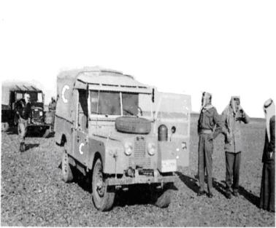
RMS Inception
Beginning:
1941: One Doctor.
Post 1948 War: Necessity emerged for a military hospital which was allocated in some barracks in Marka (Amman).
This was the nucleus of the RMS hospitals later.
1950 – 1967: two First-Aid Field Stations were established which led to the formation of Medical Battalions in 1967.
JRMS starting role confined to providing medical care to the armed forces staff.
Big Results require Big Ambitions

Slide 4
RMS Today
RMS today:
KHMC (6 Specialized Centers).
9 District Military Hospitals ( 2 new ones in handover phase).
11 Comprehensive Military Health Centers.
7 Medical Military Support Groups (Battalions) in Jordan.
3 Mobile Hospitals in Remote areas of Jordan.
Total Manpower of 18,522 Staff

Slide 5
RMS Vision
Foremost, providing the Best Healthcare to our Military and our People; embracing global advancements in quality of Medical Service.
My Mandate:
Honor our past . . . Benefit on back of our Forefathers
Serve our Country and People today . . .
Prepare for the future . . . Exploring evolution in Care
Royal Medical Services (RMS) will sustain the Army’s operational capability through the conservation of manpower – promoting health and well-being – through the care, treatment and evacuation of sick and wounded.

Slide 6
RMS Mission
Provision of safe, excellent, and highest quality Health Services on behalf of the Kingdom of Jordan and Armed Forces.
Commitment toward development and continuous Improvement – through strong Medical Certification, Professional Education, and investment in emerging medical technologies.
Lead Jordan’s regional and global healthcare prominence through partnering with esteemed medical institutions – growth through teaming, exchange and professional relations.
To provide leadership and support to reduce the loss of life and property and;
Protect National institutions and interests through a risk-based, comprehensive, emergency management program of mitigation, preparedness, response and recovery.

Slide 7
RMS Mandate 2013-2014
Providing preeminent health and wellness system to all our People.
Honoring our past, appreciating our Royal Leadership . . . delivering the best, highest quality, most advanced, affordable care.
Serving our Kingdom and People today . . . Delivering the best Doctors, Medical Professionals . . . giving the best health care; the prevention of disease and injury; while promoting health and healthy living.
Make health care better for our People and their Families
An Emphasis on Prevention
Epidemiological surveillance and ad hoc monitoring
Better Care Sooner (BCS)
Quality and Patient Safety
E-Health Technology Solutions
Childhood Obesity Prevention Strategy (COPS)
Establish Acute and Chronic Disease Targets

Slide 8
RMS Guiding Principle
Our Guiding Principle is:
To work in Interdisciplinary Partnership to respond to local, national and international public health priorities
Seeking solutions through needs for Innovation – discovery through promotion and testing of hypotheses
Validation – evidence providing what works, evaluating competency, insuring efficiency in care
Application – strengthening individual and public health actions, systems and policies

Slide 9
National Role
Comprehensive Health Care provision to 1/3 of the Jordanian Population.
Training of Physicians, Nurses and Allied Health Professions for different Health Sectors in Jordan, in addition to the RMS
Providing Tertiary Health Care Support to other Medical Institutions in Jordan

Slide 10
RMS 2013 National Statistics
No of beds: 2502
Out patient Clinic Visit: 6,104,637
Patient Admissions: 188,306
Surgical Interventions: 94,500
Deliveries: 32,221
Laboratory tests: 21,959,577
Radiology tests: 1,048.526
Patient days: 732,565
Avg length of stay: 3.9 days
Medevac (National ): 20 (International ): 35

Slide 11
RMS Medical Aid Principles
Humanity, neutrality, impartiality, non-discrimination
RMS humanitarian aid is provided exclusively on the principles of humanity, neutrality, impartiality and non-discrimination, regardless of the ethnic, religious and political affiliations of the people affected.
Needs orientation: Humanitarian Medical aid must provide a direct response to the needs of the population concerned.
Guarantee of minimum standards/evaluation
Building trust and goodwill among the civilian population toward the Jordanians
Guiding Principle – “Do no harm” – Conflict Sensitivity

Slide 12
International and Humanitarian Roles
1989 – 2014
A spirit of solidarity and shared responsibility

Slide 13
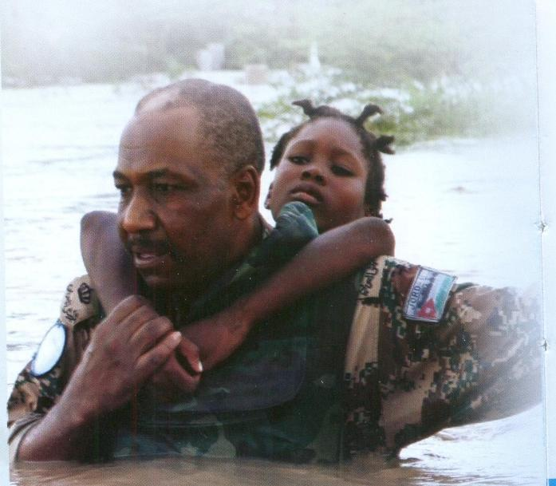
RMS Principles of Humanitarian Aid
Overarching: Conflict Sensitivity – From tragic impact of event to immediate medical needs to cultural/ethnic respect.
Humanitarian Aid based on principles of coherence, coordination and integration in the efforts of the international community.
Global Aid demands partnerships, preparedness, logistics capability and medical readiness (training, exercising & preparedness).

Slide 14
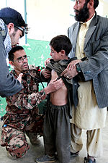
RMS is #1
Across Middle East & N. Africa
In support for
UN & Humanitarian Missions
Over 500,000 Afghans treated at HKOJ RMS Hospital in Mazar-i-Sharif
50-Bed Military Hospital treats 650 patients/day
Millions of immunizations
First time care for many Afghans
‘The Jordanian Hospital was truly a cornerstone to winning Hearts of Afghans’ – US CENTCOM DJ5

Slide 15
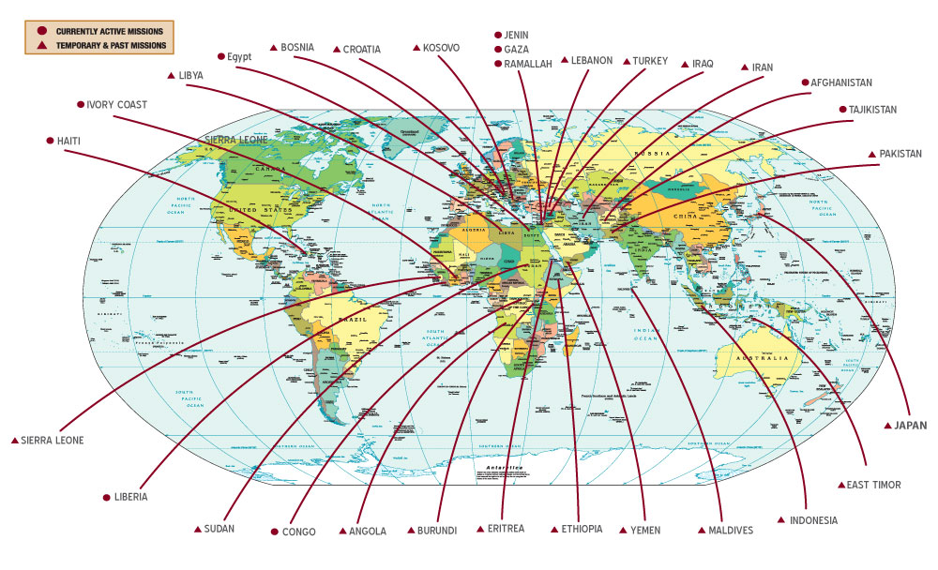
UN Peacekeeping & Humanitarian Aid RMS ‘touching’ all corners of the World
Protecting Lives
Alleviating Hardships
Safeguarding Dignity of persons/nations
HKOJ Field Hospitals
Deployed to
31
Different Locations

Slide 16
UN Peacekeeping Forces Medical Teams:
Angola, Sierra Leone, Rwanda, Liberia, Burundi, Haiti, Ethiopia, Eritrea, Croatia, Bosnia, Kosovo, East Timor, Yemen, Sudan, Ivory Coast, Tajikistan and Congo.
Humanitarian Aid Missions:
Palestine, (Gaza strip, Jenin & Ramallah) Iraq, Lebanon, Afghanistan, Turkey, Iran, Indonesia, Pakistan, Maldives, Japan, Yemen, Libya & Egypt.

Slide 17
Missions Abroad (Since 1989 - Present)
Patients 6,201,400
Admissions 31,213
Operations(Major) 49,927

Slide 18
Average Annual Numbers of Participants in Current International Medical Missions
Physicians 1336
Nurses and Paramedics 2062
Administrative Staff 2461

Slide 19
RMS International Medical Aid
Impartial Care to wounded persons and medical neutrality.
Improve Perception by the Host population, with the objectives of winning the hearts and minds of the locals and “to win the confidence”, and gain the cooperation of the local population.
Medical Assistance is an important “soft power” tool to promote stabilization and security objectives in fragile states

Slide 20
Snap Shot of RMS Missions
No greater Love then Embracing people in need
.
Hospital | Patient Visits | Surgery | Admissions
Afghanistan | 807,522 | 7,572 | 4,833
Ramallah | 884,129 | 745 | 175
Jenin | 867,095 | 7,343 | 257
Liberia | 95,787 | 921 | 5,956
Congo | 16,307 | 692 | 1,392
Haiti | 45,122 | 522 | 820
Cote D’ivoire | 37,602 | 425 | 707
Libya | 50,206 | 2,447 | 1,612
Gaza | 1,150,162 | 16,906 | 5,796
Egypt | 44,438 | 1,239 | 133
Total | 3,998,370 | 38,812 | 21,681

Slide 21
Jordan – A Refugee Haven
Circassians 1878.
Kurds 1920 & 1930.
Armenians 1930.
Palestinians 1948, 1967, 1970 & 1973.
Lebanese 1975,2006.
Bangladeshis, Philippines, Pakistanis, Indians 1991 (Gulf War in Kuwait)
Iraqis 1991, 2000, 2001, 2007.
Libyans 1900 , 2011
Syrians –1920, 1960, 1970 &2011.
“Each time a man stands up for an ideal or acts to improve the lots of others, or strikes out against injustice, he sends forth a tiny ripple of hope, and crossing each other from a million different centers, those ripples build a current which can sweep down the mightiest walls of oppression and resistance.” – Robert F. Kennedy

Slide 22
Syrian Crisis Refugees in Jordan 593,346 Registered Refugees 1,200,000 Syrians living in Jordan within Host communities & Camps 150,655 children (6 month to <15 years) received vaccinations against measles and 749 received life saving and essential Tertiary Health Care

Slide 23
The Syrian Refugees Crisis

Slide 24
Syrian Refugee Map Dec 2013

Slide 25
Syrian Crisis Impact on Jordan’s Health System
Increasing Refugee population + slow pace/stagnation of construction health facilities, the average population served by each dispensary and health centers exceeds planned population – overstretching effective functioning of current primary health care facilities.
The problem is compounded with shortage of staff, inadequate medical equipment and other supplies.
The number of Syrians in Jordan’s Public Hospitals has increased dramatically by almost 250%

Slide 26
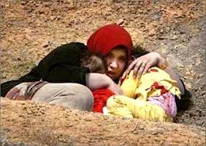
JRMS: Peace Delegates in Homeland
Under the directives of His Majesty King Abdullah II Ibn Al-Hussein, Jordanian Armed Forces (Borders Guard Forces and Royal Medical Services) joined humanitarian efforts to assist and provide aid for the helpless and insecure refugees.

Slide 27
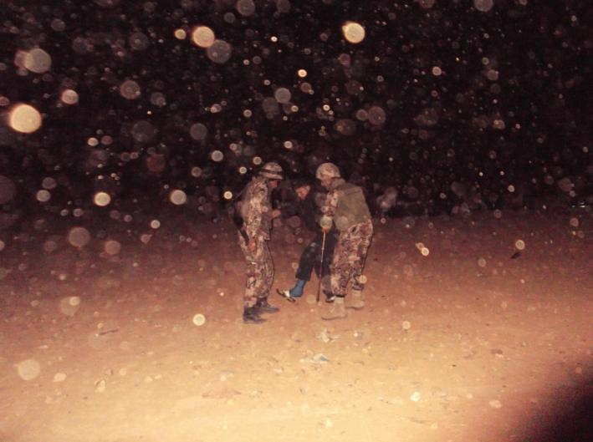
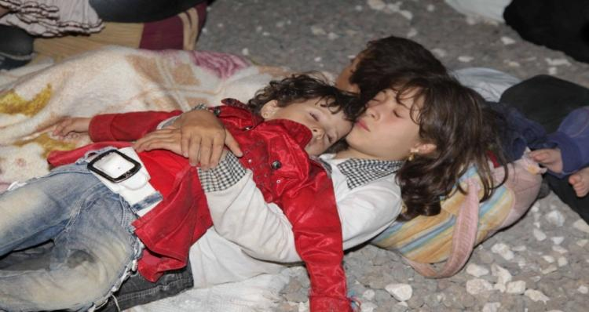
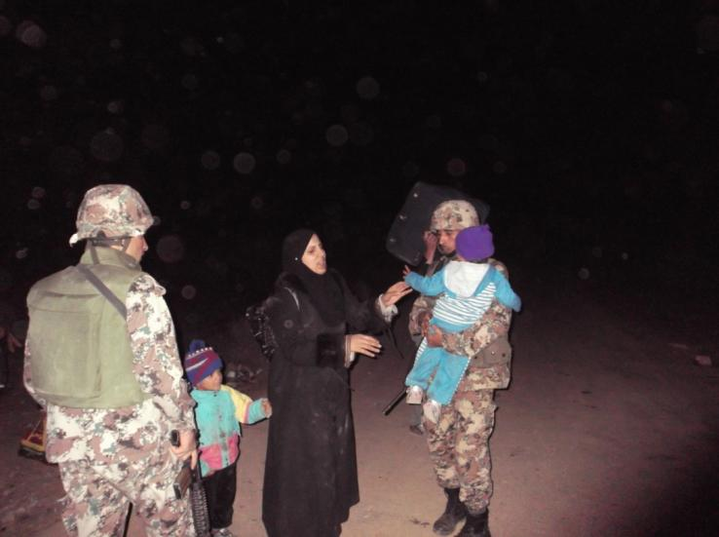
Syrian Crisis Refugees

Slide 28
Jordan Borders

Slide 29
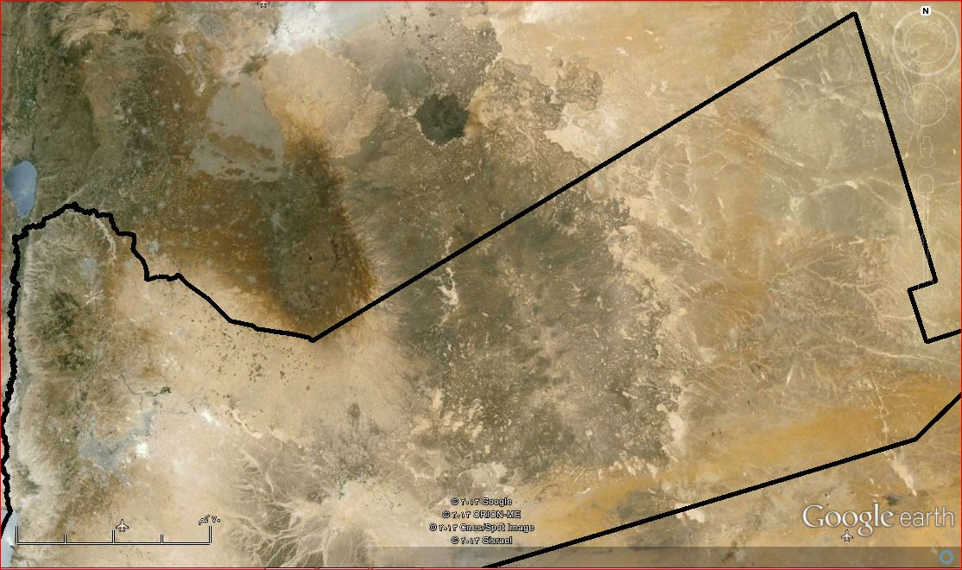
Syrian Refugees Humanitarian Aid Process
Al-Ruqban
Iraq
Al-Mutuwi
‘Hadalat
Al-Roqban
Syria
Al-Bustanah
Qalid
Al-Mintuad
Al-Mintuad
Turaybil
Al-Thunaybah
Sabha
Tal Shihab
Qalid
Al-Muqbarah
Ar-Ruwayshid
15000
Qarquosh
Al-Akaydir
Al-Mansurah
Al-Thunaybah
Tower 58
Um As-Srab
Jabir
Za’atri Refugees Camp
Refugee Crossing Point
Tal Shihab
Sama Sar’han
Jordan
Forward Gathering Point
Forward Sheltering Center
Al-Manarah
Al-Tuarah
15000
15000

Slide 30
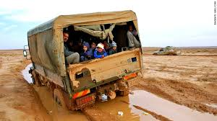
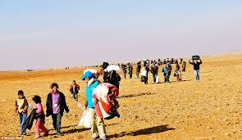
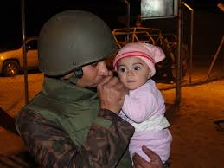
The Unsung Heroes

Slide 31
Syrian Crisis RMS Role
8 Mobile Clinics A Surgical Station with 3 ICU beds /1 Ops Room 10 Field Ambulances One Field Hospital at Za’atari Camp with 125,000 visits since Aug 2012
RMS stood up to the challenge over stretching its limited resources and erected :
Mafraq Hospital : 150 Beds with a total cost of US$75 Million
Ajloun hospital : 150 Beds with a total cost of US$75 Million

Slide 32
Syrian Refugees Crisis Medical Logistics Support
RMS Medical Logistics Support encompasses:
Medical Services.
Medical Supplies.
Medical Equipment.
Maintenance of Equipment.
RMS Medical Support operations cost:
$ 600,000 US/Month
$ 22,000,000 US to-date
Nothing more rewarding than feeling good about what you do & knowing you’re making a difference

Slide 33
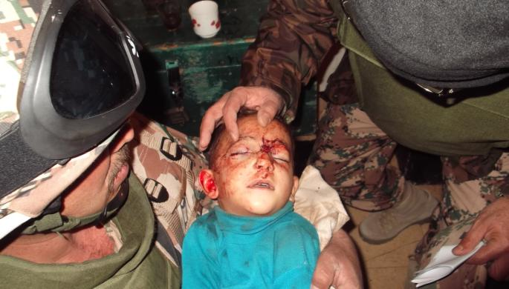
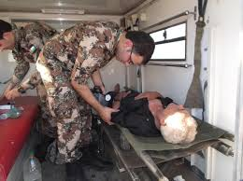
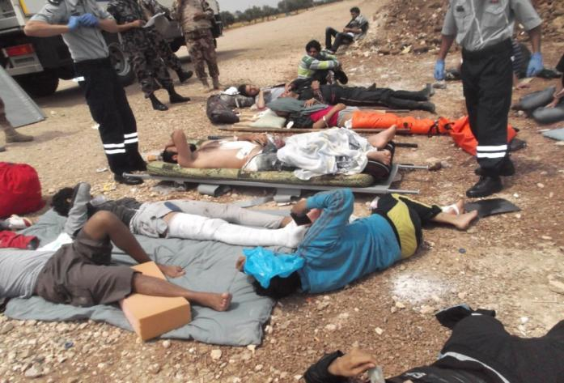
Refugees Triage

Slide 34
Syrian Refugees Crises Refugees Triage
RMS Military doctrine supports a system to triage, treat, evacuate
At crossing points, Refugees are assessed and assisted by JBGF soldiers qualified as Tactical Medics along with JRMS medical personnel.
At Clinics, causalities are triaged and primary Health Care provided
Medevac to the nearest Government Hospital if medical intervention required.

Slide 35
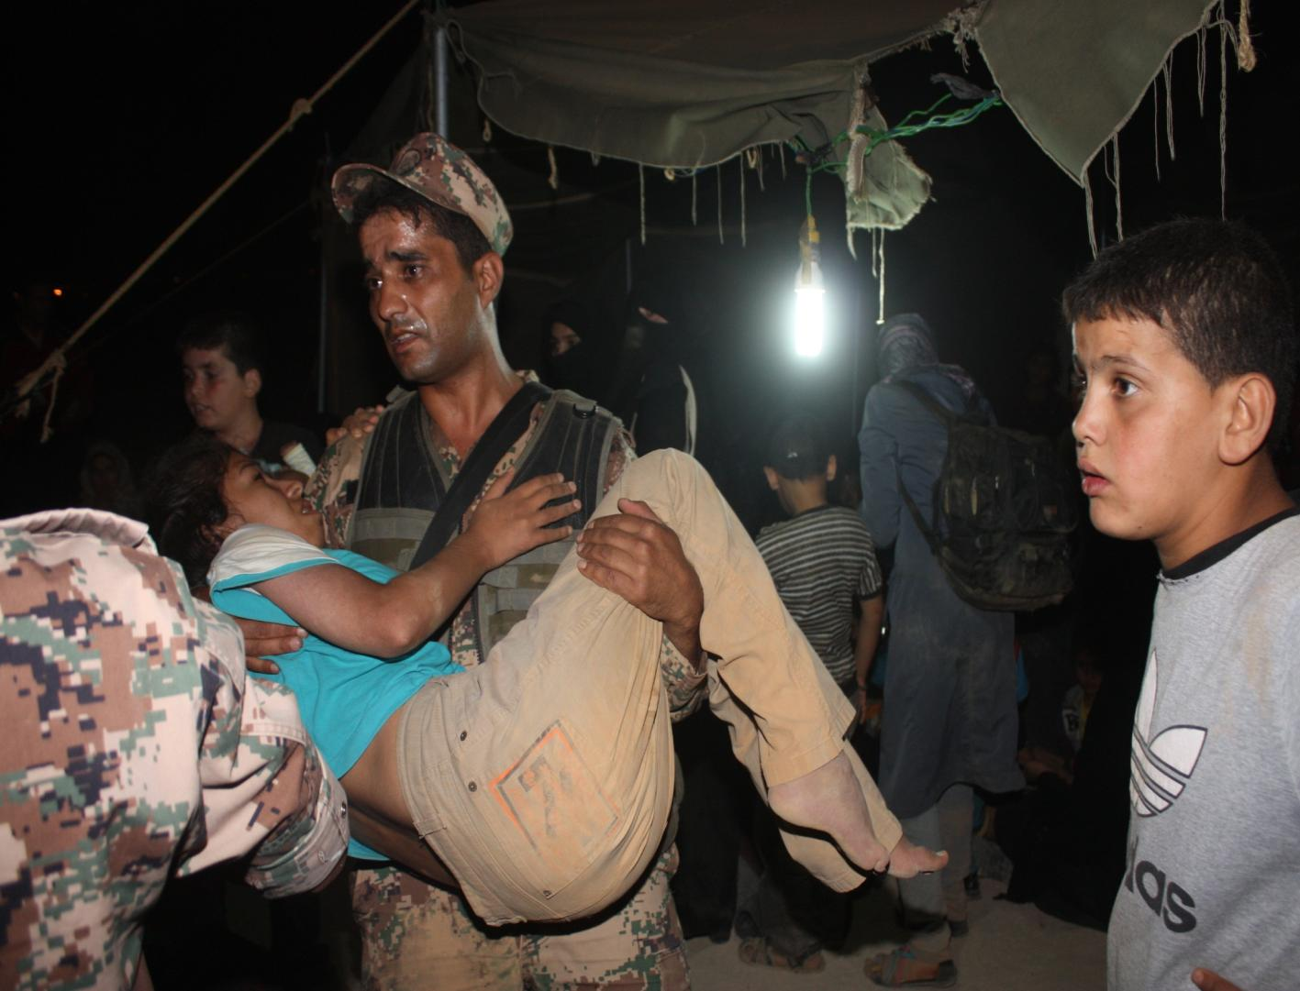
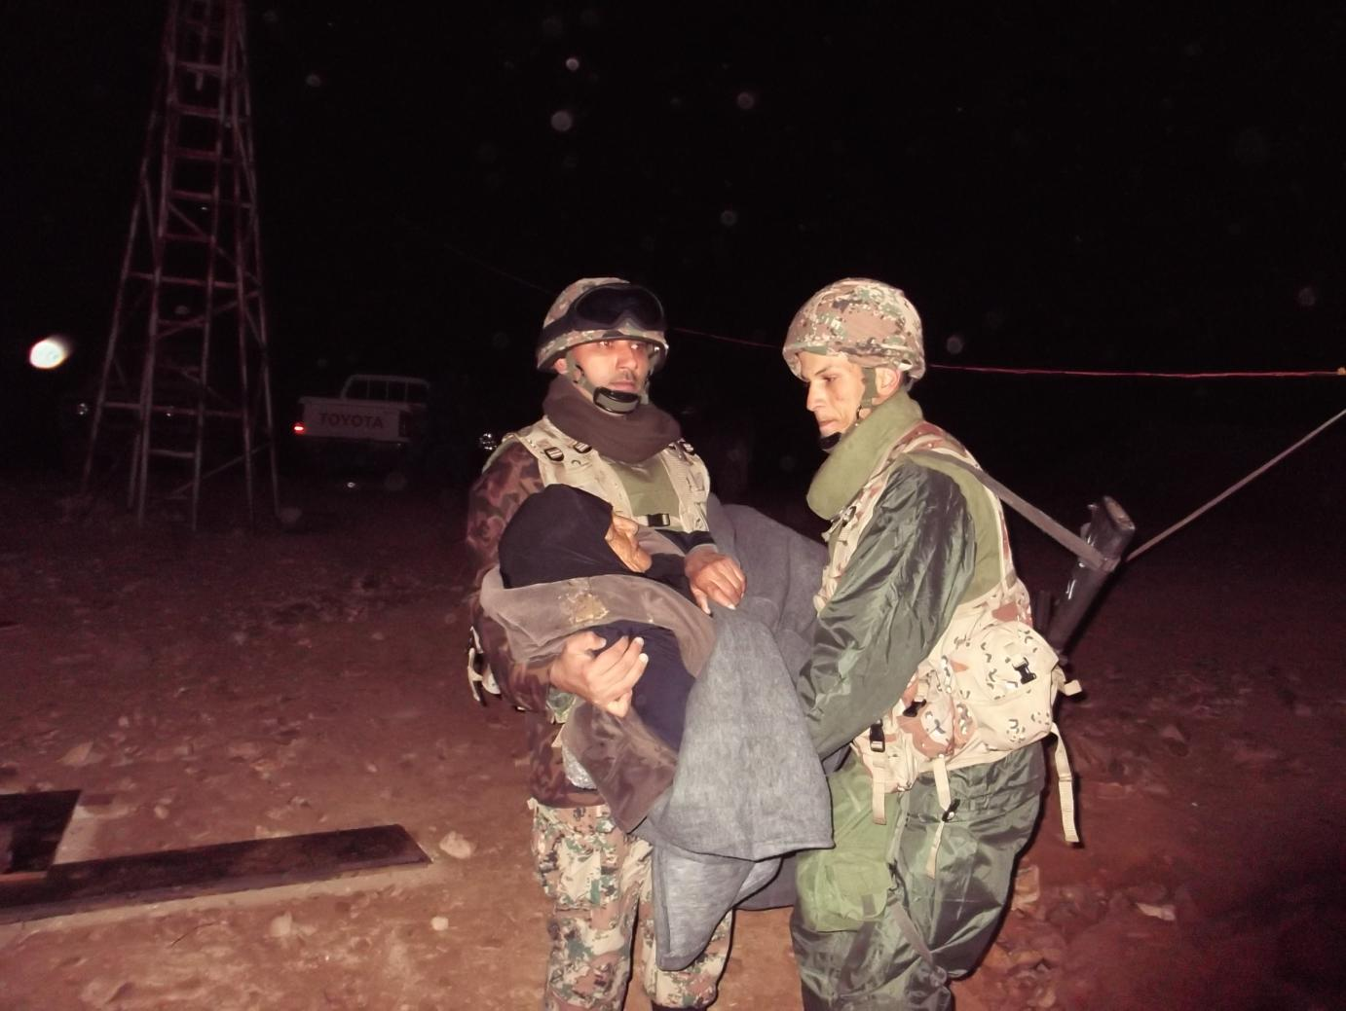
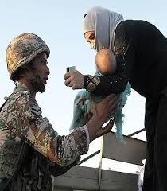
Refugees Triage

Slide 36
The Real Victims

Slide 37
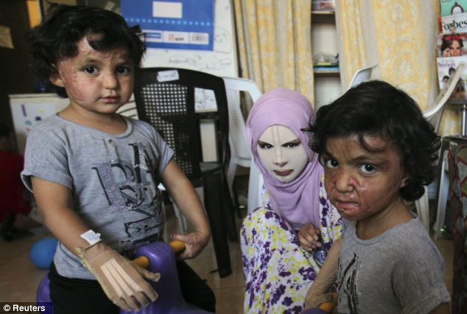
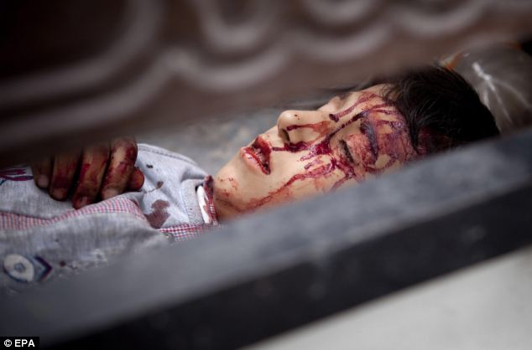
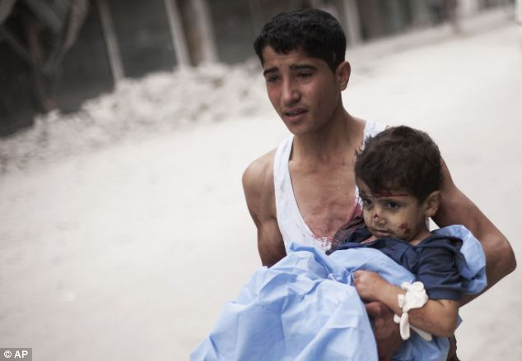
The Innocent Victims
~ 1 Million Children are Refugees ~ 11,000 Children killed in violence
~ 3 of 4 have lost a Loved One

Slide 38
Syrian Refugees Crisis Refugee’s Clinical Conditions
Chronic Health Conditions: Hypertension, DM, . . .
Acute Health Conditions: Women in Labor, Expected Delivery, Dehydration and elevated body temperature among children.
Critical Injuries: Bullet Injuries, Blasts, Burns, Amputated Limps, Fractures and other multiple injuries.
Overarching, Refugees have shown increased risk of suffering from malnutrition, anemia, tuberculosis, malaria, hepatitis and intestinal parasites

Slide 39
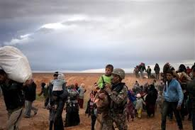
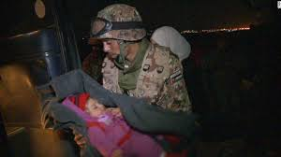
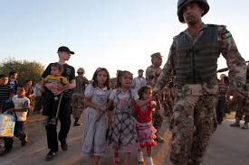
This is why we help

Slide 40
Za’atari: the Rapid Growth of the Largest Camp for Syrian Refugees
Fourth largest city in Jordan- Around 136,952 Refugees live here
World’s Largest Refugee Camp – Stretches 2 Sq Miles across
500,000 pieces of Bread/Day
4.2 million litres of water/Day

Slide 41
“Real Victories are those that protect human
life , not those that result from its
destruction or emerge from its ashes”
- King Hussein I

Slide 42
Thank You
&
God Bless

