Slide 1

Preparing Academic Success Strategies (PASS)
James Dyksen, MSEd, MA
Director, Center for Academic Success, Office of Academic and Career Success Center City Campus, www.jefferson.edu/studentsuccess
James.Dyksen@jefferson.edu 215 503 2787

Slide 2
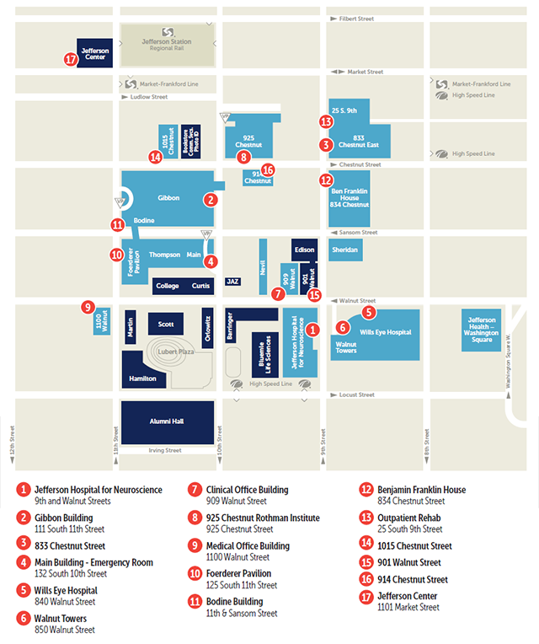
Campus maps
https://maps.jefferson.edu/

Slide 3
Center for Academic Success
Strategic Academic Support Consultations
Time Management
Study Strategies
Learning large amounts of information
Strategic study across the study cycle
Active study strategies
Effective and strategic reading, listening and note-taking
Exam Preparation and exam taking
Writing Consultations @Student Writing Center
One-on-One Consultations
Online Writing Review
www.jefferson.edu/studentsuccess
www.jefferson.edu/academic_support
www.jefferson.edu/student_writing

Slide 4

Student Writing Center
Shawn Gonzalez, PhD
Assistant Director of Writing Services
Shawn.Gonzalez@Jefferson.edu

Slide 5
Student Writing Center
One-on-one sessions with written feedback: in person or virtual
Some evening and weekend hours available
Broad experience in graduate level writing in the health sciences
Online resources (APA, grammar, paraphrase, GenAI guidance)

Slide 6
SWC support through the writing process
Understanding the prompt
Brainstorming or freewriting
Outlining
Drafting
Revising

Slide 7
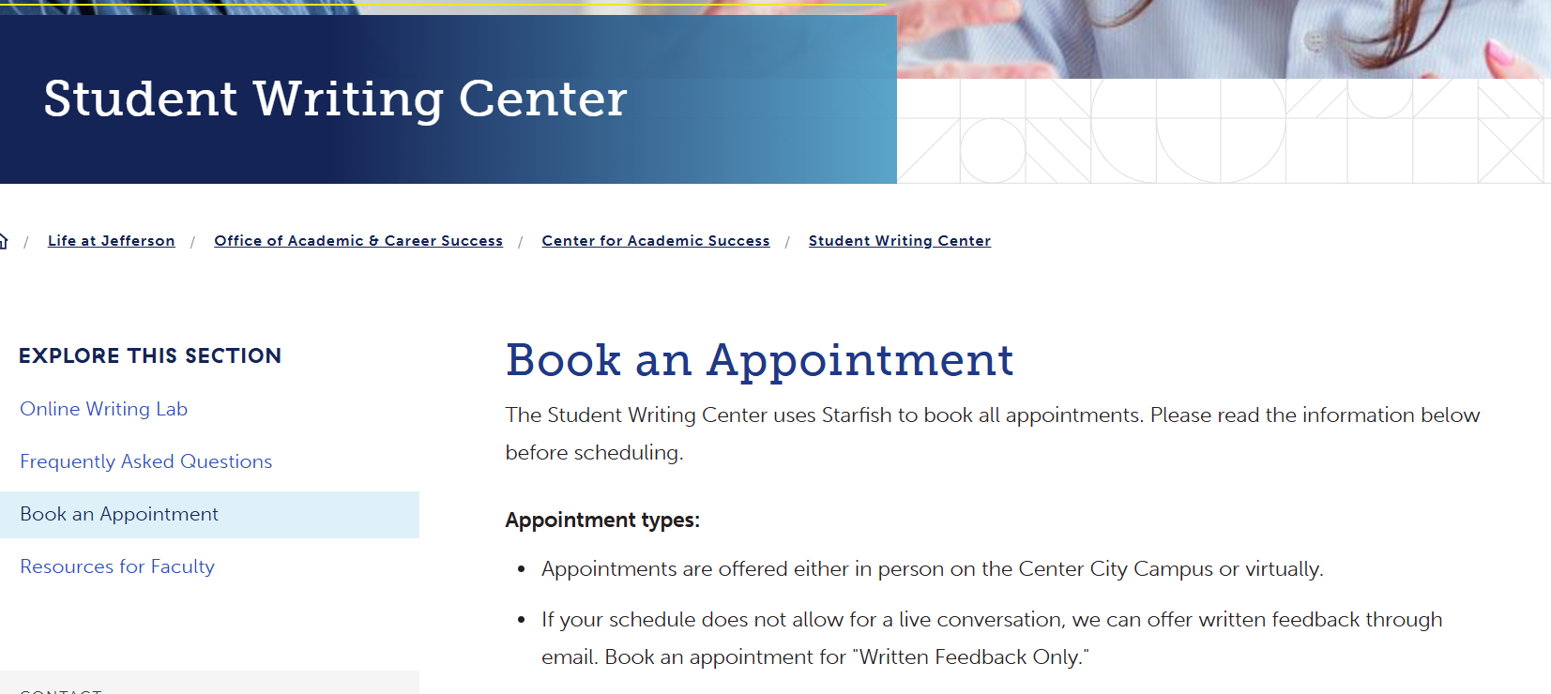
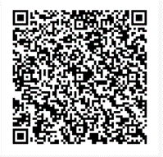

Slide 8

Office of Academic and Career Success –
Accessibility Services
Ethan Wasserman, MS
Assistant Director, Accessibility and Academic Success, ethan.wasserman2@jefferson.edu, 215 503 6531
Notes:
Hello, my name is Ethan Wasserman and I am the assistant director for accessibility and academic success. I work with Jim to provide academic support for students and I help with anything related to accessibility. Today I will be going over how to request accommodations.

Slide 9
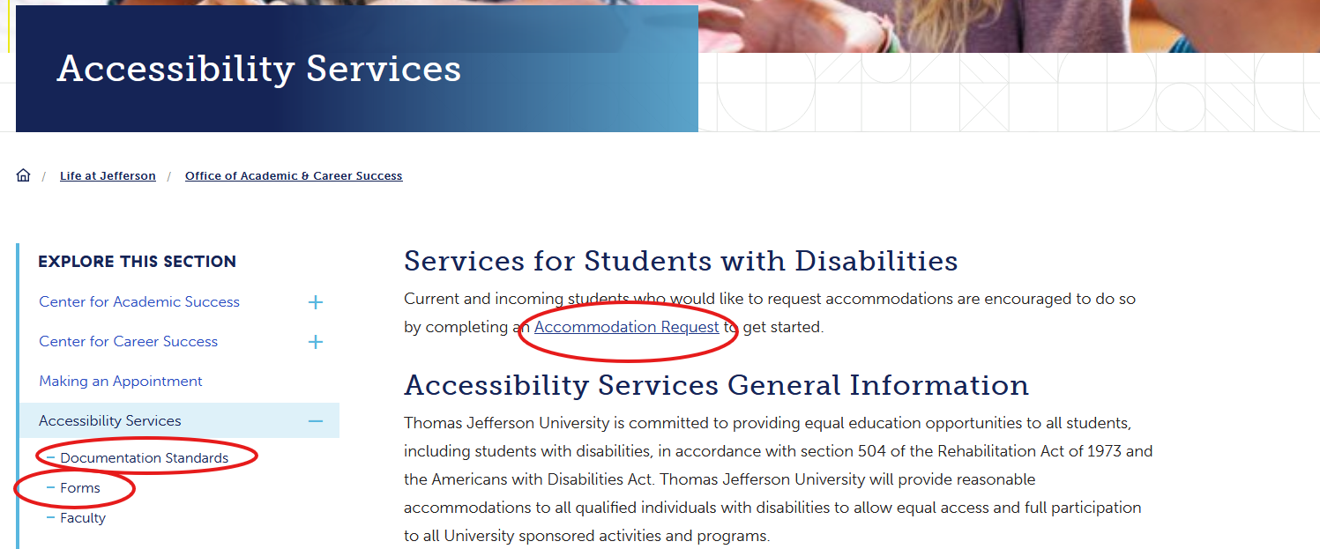
Making a Request – Jefferson.edu/accommodations
Notes:
Accommodations are for those who have a disability, this could be a diagnosis that is new, old, temporary, or chronic. To start an accommodation request, go to Jefferson.edu/accommodations and then click on the link in the center of the page that says “accommodation request” When making an accommodation request, you should include documentation from an appropriate medical provider that supports your diagnosis. If you don’t have supporting documentation that’s okay. You can still make a request. There is a medical intake form in the form section that you can have your provide fill out. If you are having trouble getting a diagnosis feel free to email me and we might be able to help you find a medical provider. You can read more on what we are looking for in documentation in the documentation standards section.

Slide 10
Student Panel – representing JCRS…
Carly D’Angelo, OTD
Ella Waddell, OTD
Introductions – program, year, and favorite thing about being a student at Jefferson?

Slide 11

Welcome!
Our goals:
Build awareness and encourage metacognition
Introduce study strategy adjustments you might need to develop
Encourage strategic and honest time management
Encourage strategic, active, efficient study and learning
Encourage communication and collaboration
Encourage use of resources

Slide 12

Agenda
Introductions and agenda
Active Study Strategies and Learning Efficiency
Developing Time Management Strategies
Strategies for Test Preparation and Test Taking
Proactive Use of Available Resources
Wrap up and final comments

Slide 13
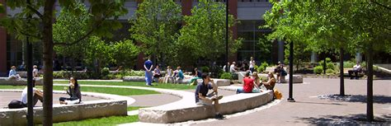
Our Role in Academic Success
      Our focus is on helping students to learn more effectively at Jefferson, and to develop lifelong learning strategies.
      We work with students across all of Jefferson’s programs.
      Most of our work is with students who want to improve and want to develop more efficient study strategies given the demands of their degree program.

Slide 14
We Believe…
        Every student admitted to Jefferson can succeed here.
        All Jeff students arrive with strengths and experience, and we want to help you build upon those strengths…
        However, it is also the case that many students find they need to develop (new) strategies to be more efficient and successful – strategies you are capable of using well, but may not have needed before.

Slide 15

    Characteristics of Successful Students
    Inquisitive
    Resilient / Adaptive
    Reflective
    Responsible for their own learning
    Balanced
    Thoughtful about Application of Learning

Slide 16
Metacognition - Thoughtful analysis and awareness of what works to encourage learning for you… and adjustments that might help
The ability to:
think about one’s own thinking
choose practices that encourage deep, flexible, reliable learning
be consciously aware of oneself as a problem solver
monitor one’s mental processing
accurately judge one’s level of learning
make strategic adjustments in learning practices
McGuire, Saundra Yancey. 2012. Teach STEM Students How to Learn: Metacognition is the Key! Powerpoint presentation.

Slide 17
Process of Collaborative Problem-Solving
Strategic Academic Support Consultations
Analyze
Strategize
Apply
Reflect

Slide 18

Critically reflect upon your study strategies…
Let’s plan to build on strengths
Raise your hand if you agree with the following statements?:
I have a system for studying and for managing all of my coursework.
I believe my previous study methods will be effective here at Thomas Jefferson University.
I am confident I can effectively make adjustments to learn effectively and efficiently.

Slide 19
A question for chat
What do you think you might need to work on or adjust as you begin your new program?

Slide 20
Questions you most want to discuss today – (CoPilot summary):
Top Questions & Concerns ⏰ Time Management & Work-Life Balance How do I manage classes, clinicals, work, and family responsibilities? How much time should I study each week? How can I avoid burnout? 📚 Effective Studying & Learning What study methods work best for nursing and graduate school? How can I learn more efficiently in less time? How do I retain information long-term? 📖 Reading & Information Overload How much textbook reading is necessary? How can I manage large reading assignments? What strategies improve reading comprehension?
📝 Exams & Test Anxiety
How should I prepare for quizzes and exams?
How do I handle test anxiety and stay focused?
What is different about nursing school exams?
🎯 Focus, Memory & Attention
How can I stay engaged and avoid mental fatigue?
How do I improve concentration and recall?
What tools (e.g., Anki) can help me learn efficiently?
🤝 Resources & Student Support
Where can I find tutoring, library, and academic support services?
What accommodations and accessibility resources are available?
How can I make the most of Jefferson's resources?

Slide 21
Questions you most want to discuss today
Balancing work, orgs, classes and studying for standardized tests
How to stay organized and be a strong student
Would you be able to cover time management of classes while also working full time?
Efficient and Effective Study Strategies - Graduated from Undergrad in 2021 (& a little worried about getting back in the traditional classroom)
1. How not to fall behind 2. How not to get overwhelmed with the volume of material 3. When and when not to use textbooks
Exam preparation and test-taking strategies
I am interested in learning more about specific tips for online/remote classwork.
Adapting to a new city and curriculum simultaneously
How do I go about finding time to study after classes and then rotations? How can I best be proactive for such a demanding semester?
How to manage studying time and lab rotations.
just making sure I complete everything before it is due
Time management, effective studying, exam taking, etc…
As an international student, I would like to know how I can fit into the US educational system. How can I make the most out of it?
Online student switching to in-person.
Study strategies
Tips for individuals who sometimes struggle with focusing.
Adult students returning to college if possible
Organization and time management
Time management, better ways to study, sources to help with material

Slide 22
Website : www.Jefferson.edu/studentsuccess
Resources available on demand
Spaced Repetition and Self-Testing
The Study Cycle: An active, process-oriented approach to study
Study groups as part of effective, efficient, active study
Working with focus, purpose and grit: Strategies for dealing with anxiety in study and testing
Test Preparation and Test-Taking Strategies
Using Academic Resources

Slide 23
Student Panel – representing JCRS…
Carly D’Angelo, OTD
Ella Waddell, OTD
Looking back at first semester / first year, what adjustments did you need to make? What lessons were important?
What do you wish you had known then?

Slide 24

Adjusting the Study Cycle: Developing Active and Efficient Study Strategies

Slide 25
A question for chat
What study practices or learning strategies have you relied upon most?
What study resources or tools do you find effective / useful?

Slide 26
A question for chat
What are we going to say today?
What do you already know about learning/study strategies/time management?

Slide 27
Resources available for review of Study Strategies
Adjusting and Improving Learning Strategies
  Make it Stick: https://www.youtube.com/watch?v=MfylloWuuZU
  Learning Scientists: https://youtu.be/CPxSzxylRCI
  Osmosis: https://www.osmosis.org/learn/Spaced_repetition and https://www.osmosis.org/learn/Testing_effect
The Office of Academic and Career Success, Center for Academic Success-
Please visit our website: www.jefferson.edu/studentsuccess

Slide 28
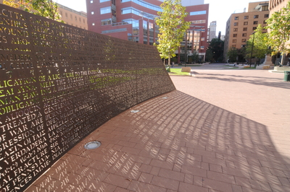
Your Key Takeaways from:
Adjusting and Improving Learning Strategies
What do you remember?
What seemed valuable advice?
What do you plan to put into practice?

Slide 29
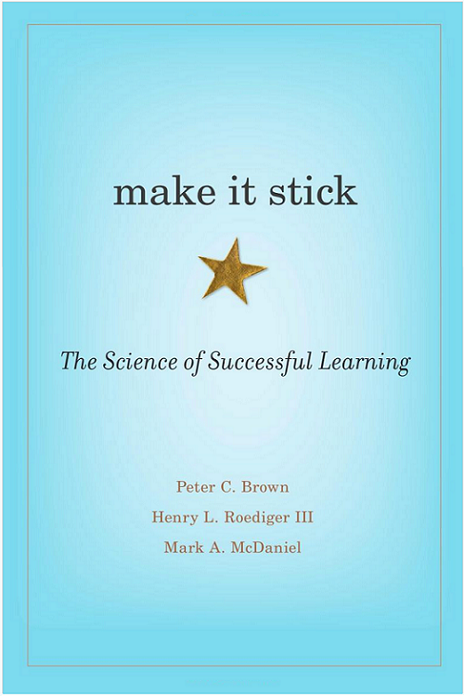
Key Lessons for students from Make it Stick: The Science of Successful Learning (Brown, Roediger & McDaniel, 2014)
Practice retrieving new learning from memory
Space out your retrieval practice
Build variety into your study practices
Incorporate varieties of self testing – early and often
Effortfully engage with material in multiple passes
Notes:
Again, the emphasis here is on the value of effortful practice with new learning, repeated over time– trying to demonstrate recall, solve problems, answer questions, or use new information – and then using feedback from these efforts to inform study and review. Evidence indicates that such spaced, effortful practice and correction based on feedback leads to more learning and better long-term retention and flexibility of recall and use (use baseball example). Handouts – again – key lessons from – kind of like what we already have but simpler

Slide 30
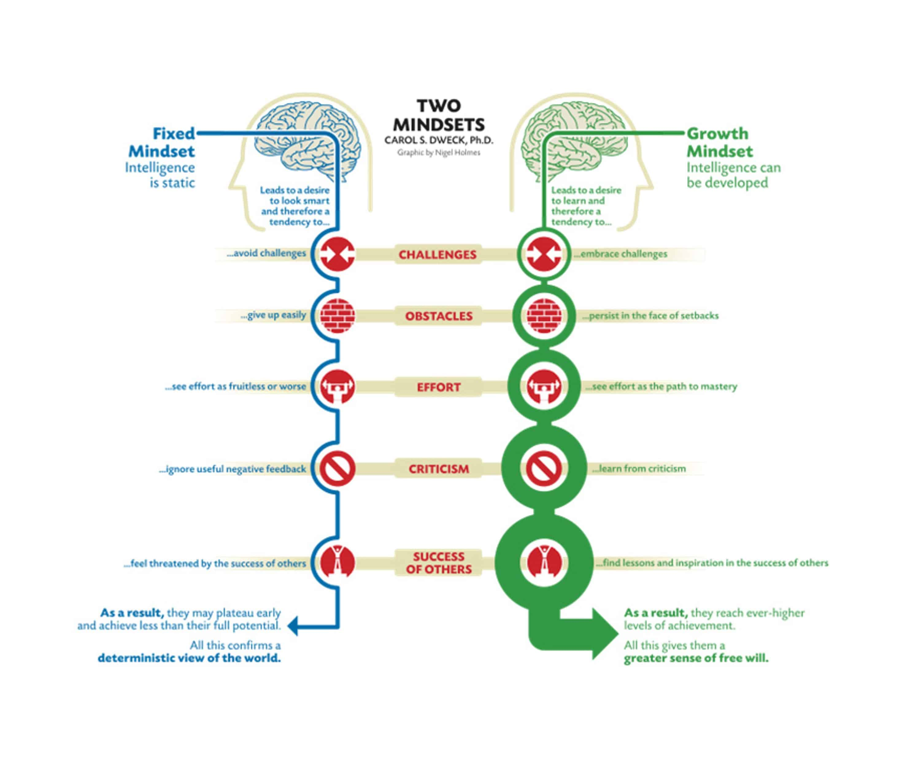
Growth Mindset

Slide 31
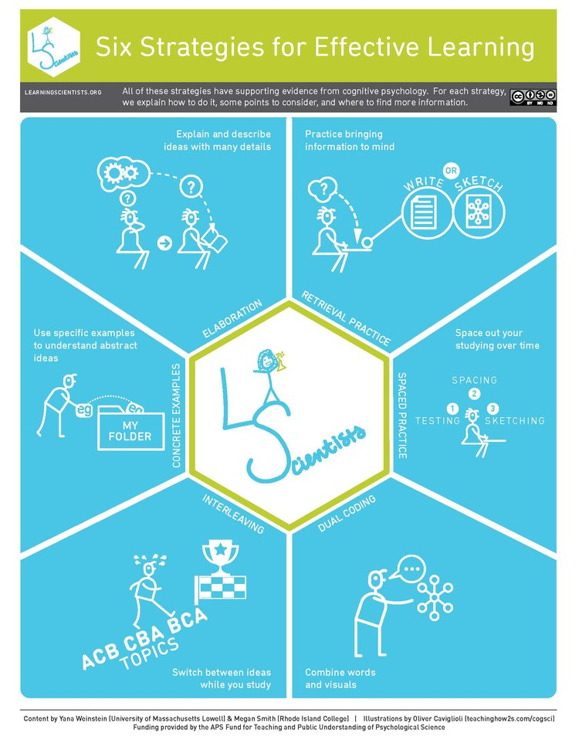
Strategies described by the Learning Scientists

Slide 32
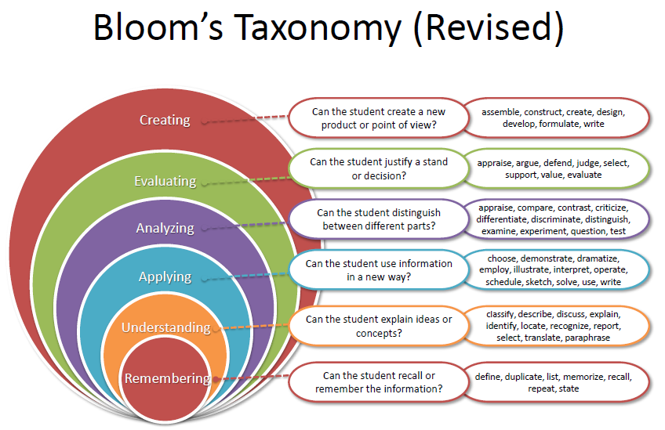
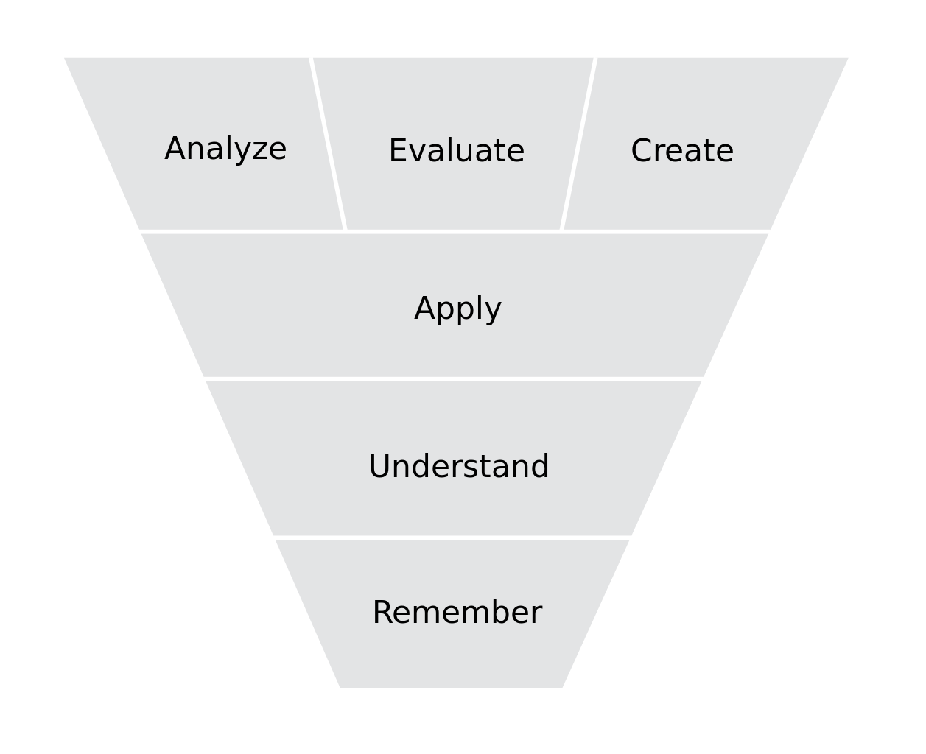
Bloom’s Taxonomy – The best way to reinforce recall and understanding is to test it with higher order tasks
Notes:
Emphasize that challenging recall and understanding with higher order tasks is the best way to reinforce and develop recall and understanding and deepen retention. Do it early and often, in a variety of ways

Slide 33

A shift in balance:
From - labor intensive “front-end” work building a full outline or study guide to then “go over” and review… the objective being to comprehensively study, study, study and then, later, test.
To – more efficiently developing a foundation from which to begin a progression of active, practice-based, question-based study and self-testing as a learning method that then points to priorities for targeted review and study.
Notes:
One still needs to do some work becoming familiar with new material, developing a foundation of understanding and memory, but the shift described here involves doing that work over a shorter period of time and moving more quickly to work that is practice-based, question-based and intended to test recall, understanding and ability to apply… This effort-filled work provides feedback on what to study – study that then leads to more self-testing

Slide 34
Adjusting the Study Cycle –
Planning for multiple passes working with material
1. Previewing / Pre-Reading
Use best resource(s)
2. Lecture/ Note-taking
Attend lecture
3. Processing /Reviewing /Planning subsequent study
4. Active study / self-testing
Generally brief
Prep for good listening and note-taking
Relax / Listen / See slides
Annotate - Note importance, emphasis, questions, resources to use
Not meant to be comprehensive
Work toward synthesis and summary that reflects your understanding
Stages 1-3 happen ideally within a day or two of encountering new material.
Identify gaps to fill, and questions to ask
Plan resources to use and strategies for subsequent study.
Strategic
Balance and variety – plan a progression of varied activities
Test recall, understanding, and ability to apply information
Plan for daily review and active study
Self-test regularly using a variety of methods
Notes:
The study cycle as presented here includes active study and self-testing as a robust, varied stage - combining elements of review, self-testing and study in a pattern that begins with elements of self-testing and goes to study as needed to answer questions. The last stage here is meant to describe activities that take place after the day 1-2 foundation-building work. Handouts – some version of this will be a handout

Slide 35
Set up Documentation – Ways to build noticing

Slide 36

Main points of emphasis
Survey resources. Make informed decisions about what to use, when to use it, and how to use it.
Plan your study time. Commit to practices for periods of time. Build in breaks – rest, assess, plan what comes next.
Challenge yourself and start testing yourself early and often – before you are ready. Use feedback to inform your study. Repeat.
Do more questions: Always be on the lookout for questions! Identify best ways (and varieties of ways) to self-test.
Be Strategic in your Study. Every time you study think about: Goal, Resource, Time, Plan for next time.
Notes:
Wrap up

Slide 37

Good decision-making about AI use (or not)
Should you use AI tools as part of your study practices?
If so, how can you go about doing so ethically and with transparency?
If so, what are the best ways to do so, and what functions contribute to learning?

Slide 38

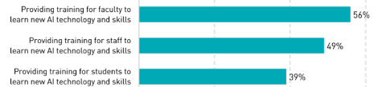
Percentage of respondents (N=802) who report that their institution is:
(Robert, 2024)

Slide 39
Jefferson student perspectives
Fall 2024
196 students from College of Rehabilitation Sciences
 | Varied student behavior
6% | use GenAI most or all of the time
50% | use GenAI some of the time
44% | do not use GenAI
 | Need for training
25% | do not understand their responsibility for accuracy of GenAI.
59% | do not know how to indicate the use of GenAI.
26% | report not having resources needed to use GenAI for school.
(Dekerlegand et al., 2025)

Slide 40
Our advice
Review University policy and program handbook
Know faculty guidance – seek clarity if not in syllabus
If used, always work with a body of information you trust – course materials
If used, use in latter stages of study, not early
If used, actively use critical thinking, questioning and double check everything against course material

Slide 41
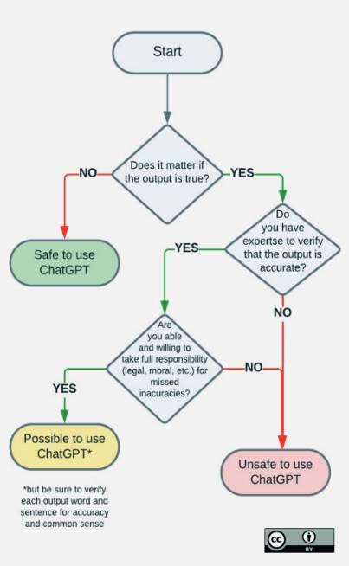
Decision-making framework
Questions:
Is it permitted?
Is it reliable?
Will using AI in this way advance your learning?
We recommend that you only use Generative AI in situations where you can confidently answer “yes” to all of the above.
ChatGPT and Artificial Intelligence in Higher Education: Quick Start Guide by Emma Sabzalieva and Arianna Valentini, UNESCO, 2023. Flowchart by Aleksandr Tiulkanov, January 2023, p. 6.

Slide 42
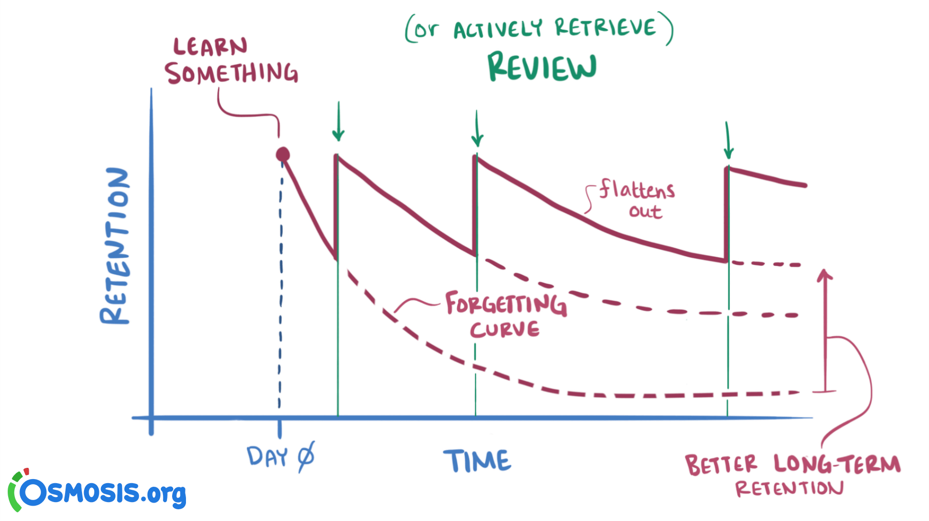
Study Strategies and Study Plans for incrementally building mastery depend upon good, thoughtful time management
See your week – how much time for study do you really have?
Explicitly plan your study time – write it out.
Plan to effectively space out study - work with material for set times over different days.
Avoid the need to cram – cramming is not learning
Notes:
Emphasize the need for more explicit planning of study blocks than students may have ever needed before – and some kind of accounting of what is covered and what priorities remain for larger blocks of time available on weekends or non lecture days. Handouts – time management

Slide 43
Student Panel – representing JCRS…
Carly D’Angelo, OTD
Ella Waddell, OTD
When you think about how you approach stages of the study cycle or active study - what has worked well for you and what adjustments have you made in your study practices?
Any advice for asynchronous learning or use of online resources?

Slide 44

Student Panel – Q and A

Slide 45

Time Management Strategies

Slide 46
A question for chat
What time management resources or tools do you find effective / useful?

Slide 47

Getting Organized and Studying Efficiently
Goals:
Discuss strategies for efficient time management
Detail ways to make your time visual and plan your week and day

Slide 48
Time Management is a Process of Mindful
Planning
Action
Reflection

Slide 49
The Purpose of Managing Your Time is…
…absolutely about being able to get more done in the time available to you…
…but NOT solely about getting more things done: it’s also a tool to minimize stress…
…and help you live your life more like how you want to — not just fit more stuff into it.

Slide 50

The First Step: Make Your Time Visible!

Slide 51
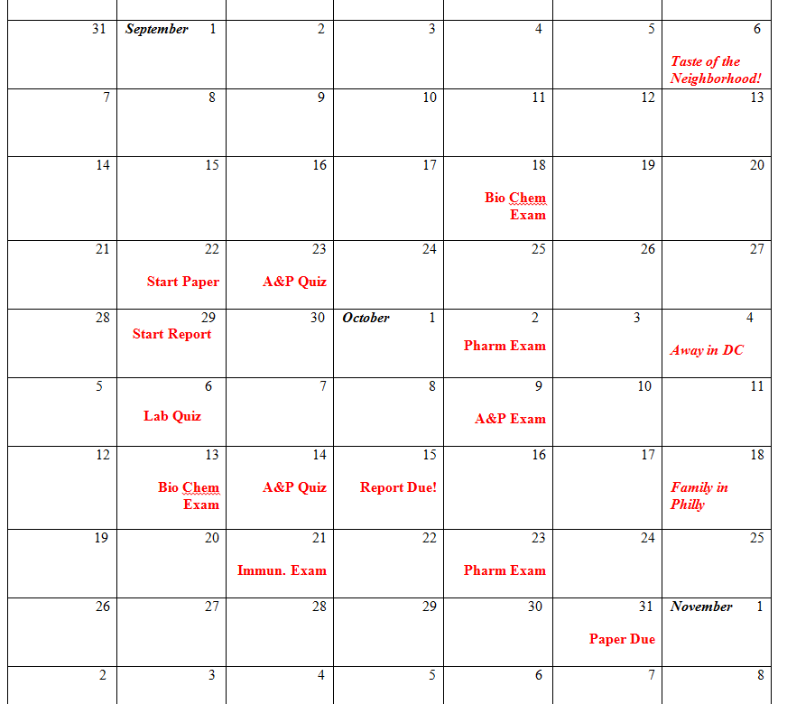
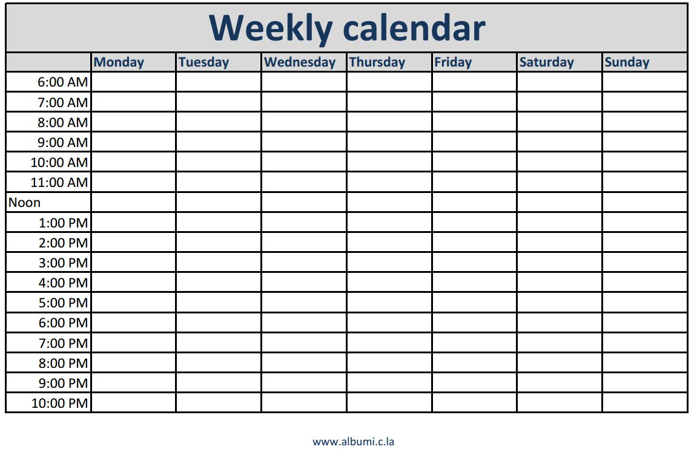
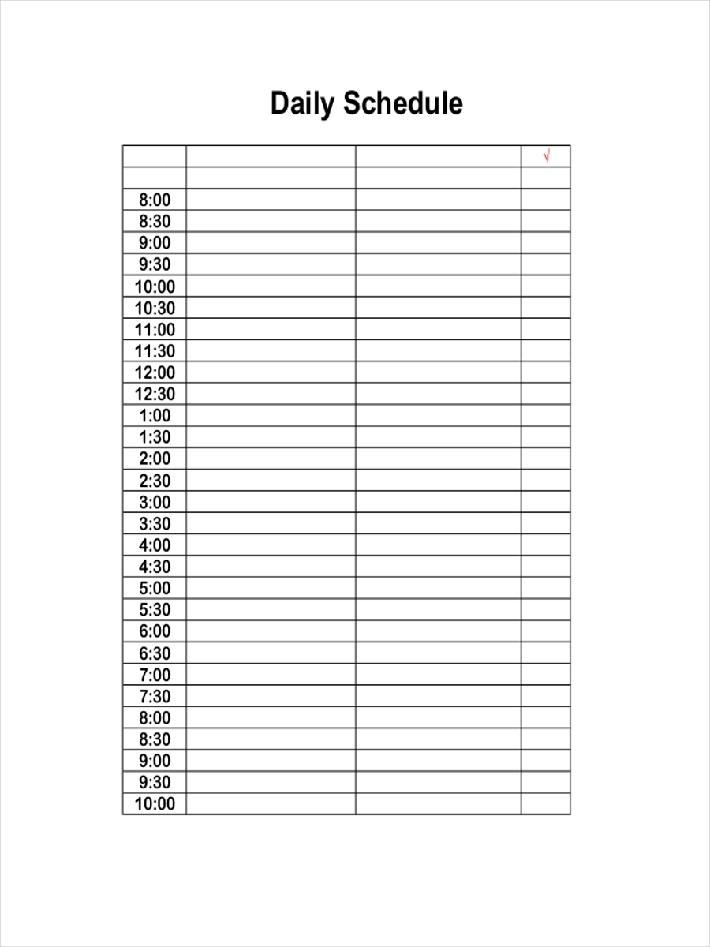
Three Levels of Organization
Semester
Week
Day

Slide 52

Semester Calendar
  Key due dates (exams, papers, etc.)
  Start dates to projects
  Other important obligations
  Extra-curricular life events (holidays, family visits)
  Create your own deadlines as needed!
Notes:
Monthly calendar
Your master schedule should give you an overview of every assignment, exam, and deadline over the entire semester
You do not necessarily need your master schedule with you at all times – you will transfer items to your daily schedule to get you through each day

Slide 53
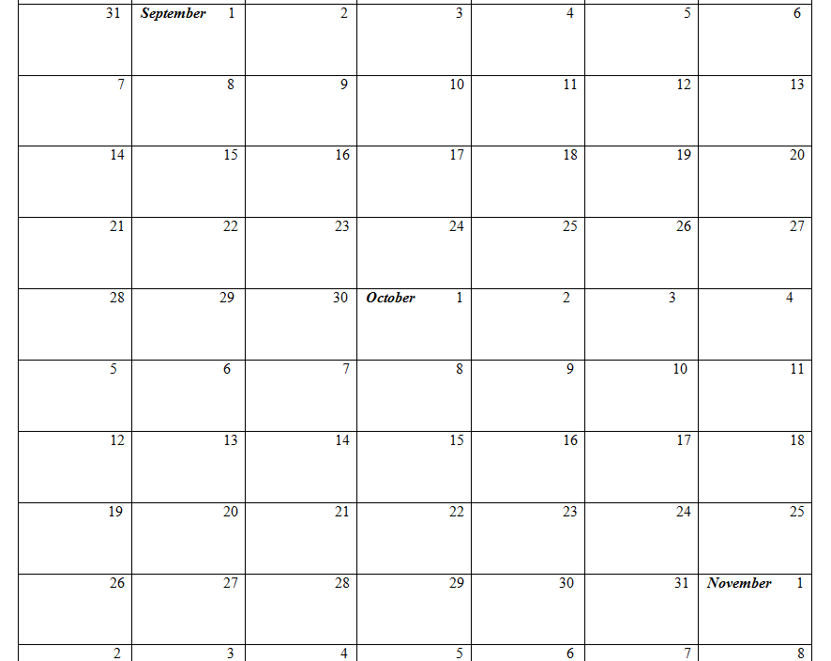

Slide 55
Short-Term Planning: See Your Week!
Fill out your weekly grid with:
Requirements (synchronous class components and other committed time)
Blocks of time for important activities that may be non-school related (meals, exercise, work… sleep!*)
Identify your windows of opportunity for study for each day
Plan a progression of activities for targeted courses (New material and Review)
*Remember to think about when you will get up in the morning and go to bed at night!

Slide 56
 | Sunday | Monday | Tuesday | Wednesday | Thursday | Friday | Saturday | To Do List
6-6:30
6:30-7
7-7:30
7:30-8
8-8:30
8:30-9
9-9:30
9:30-10
10-10:30
10:30-11
11-11:30
11:30-12
12-12:30
12:30-1
1-1:30
1:30-2
2-2:30
2:30-3
3-3:30
3:30-4
4-4:30
4:30-5
5-5:30
5:30-6
6-6:30
6:30-7
7-7:30
7:30-8
8-8:30
8:30-9
9-9:30
9:30-10
10-10:30
10:30-11
11-11:30
11:30-12

Slide 57
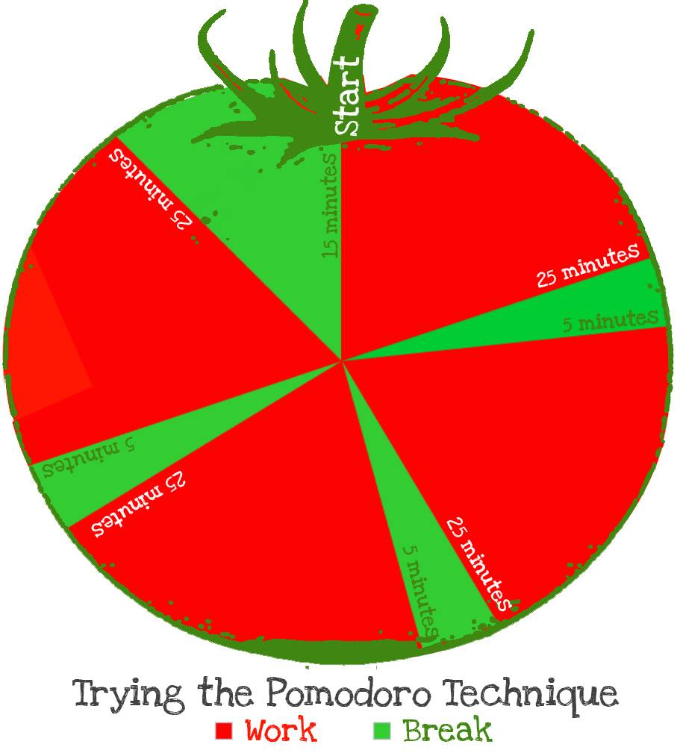
Daily study plan - detail what you will do with blocks of study time
Plan:
  Progression of activities (and courses to address)
  Variety of activities
  Time for each activity
  Breaks in between
  Adjust as needed while keeping to general priorities
  Keep a record of what you do… and what you most need to work on

Slide 58

If procrastination is an issue…
Procrastination is not the result of lack of will…
Try to notice factors that lead to procrastination
Do not dwell on finishing, but rather starting

Slide 59

Understanding Procrastination – and what to do to get started…
https://weingartencenter.universitylife.upenn.edu/combating-procrastination/

Slide 60
Reflection Questions
“What goals did I accomplish today, or this week?”
“What worked well?”
“What didn’t work well?”
“What work didn’t I get done?”
“When can I next work with that material?”
“Why didn’t I have enough time to [study, socialize, exercise, etc.]?”
“What do I need to change in my schedule (or life) in order to accomplish this goal or find more balance?”

Slide 61
Student Panel – representing JCRS…
Carly D’Angelo, OTD
Ella Waddell, OTD
Please share advice about time management – and specifics of any resources you use, or adjustments you have had to make, etc…

Slide 62
Student Panel – Q and A

Slide 63
Some takeaways about Time Management
See your time – make your time visual and be realistic about how much study time you have each day, each week.
Be flexible and be willing to make adjustments as needed
Plan your time – you will likely have to explicitly plan your time, and especially your study time, more than you ever have needed to before.
Think about how much time to give to each activity in a progression of activities

Slide 64

Test Preparation and Test-Taking Strategies

Slide 65

Study Strategies – Test Preparation
Exam preparation leads to performance
  …and this prep highlights the TM and AS strategies we have been discussing
Study subjects at regular intervals every week
Use active study techniques that involve answering questions and self-testing as early and as often as possible
Do more questions – and use feedback to guide targeted review
Notes:
How you prepare for an exam is the most important predictor of success. At this level you need to be studying consistently.
As a student in the health sciences most of what you learn here you will DO in your practice as a health professional.
So you will need to learn how to APPLY what you’ve learned into your practice.
You must ACTIVELY engage with the material and study it, chunk by chunk, every day to truly learn and be able to apply the knowledge.
One goal should be to create a study plan that lays out what you will do in each course. It is imperative for your success to review material between lectures and preview new material prior to the next lecture.
This way you can begin to assemble your questions and synthesize the information as you slowly approach the exam.
Studying consistently in chunks or blocks of time will boost your ability to commit the information into long-term memory and avoid ‘cramming it’ right before the exam.
Also try to create study tools and aids (charts, concepts maps, diagrams, etc.) as you review the lectures. These tools can come in handy when the exam is near.

Slide 66
Types of Questions – What do I need to know… and how do I need to know it?
Knowledge
Comprehension
Application
Analysis
Notes:
The upside down triangle is called Bloom’s Taxonomy.
While you may be unfamiliar with this graphic, your professor’s are not.
Test-makers use this model to develop questions to test how well you know the material.
Most of the questions you’ll be asked will be testing your ability to know, comprehend, apply and analyze.
This means you have to study and know the material in a deeper and more meaningful manner.
This is why many nursing questions are case studies, they’re assessing how you would apply what you’ve learned in a real-life scenarios.

Slide 67

Test-Taking Techniques
Multiple choice is about narrowing down your choices
The goal is to narrow down as much as possible to the best answer
Prepare to choose from several closely related answer choices.
Always think – “What is this question asking? What is being tested here?”
Notes:
Now we shift our focus to the process of taking an exam.
Many of the strategies I will discuss have to do with being able to narrow down the answer choices in a
MC test to the BEST answer.

Slide 68

Overview of an approach to complex MCQs
Read the last two sentences of the stem first. What kind of question / what is being asked?
Briefly preview answer choices
Then read the whole stem carefully, noting keywords and details. (Use highlighting and scratch paper…)
Pause to think, simply, in one sentence, what the question is asking. Try to anticipate answers.
Proceed to a thoughtful, precise comparison of each answer choice – don’t be too quick to go to a pre-determined choice, but don’t overthink either. Be deliberate.
Notes:
One of the most important factors when approaching a MCE is to closely read the stem.
Consciously read the question and then think of the answer in your head before you analyze the provided answers.

Slide 69

Test-Taking Techniques – Key Words to notice
Identify key words in the stem that indicate negative polarity or that express an absolute (always, never…)
Identify key words in the stem that set a priority
Identify clues in the stem
Identify specific determiners (only, for example)
Identify opposites in options
Identify equally plausible or unique options
Identify duplicate facts among the options
Use scrap paper to make note of key words or essential information as you are reading the stem.
Anticipate answers before going to answer choices
Notes:
The following ten strategies are common signifiers in MC questions that can help eliminate incorrect answer choices in order to narrow down the correct answer

Slide 70

Examplify strategies
Pace – keep up a good pace, but don’t worry if some questions take a bit longer or if you need to read twice. Use practice and prior experience to assess how much time you need. Check in on time at spaced intervals.
Flagging – flag after giving a question a good, thorough attempt; flag questions you would benefit from doing in a second pass. Don’t over flag.
  Maybe return to flagged questions after doing a few “easier” questions (see chunking below). Don’t save all flagged questions until the end.
Often a good practice to chunk the exam into manageable sets of questions – 10, 15, 20? Do them with purpose and then pause and give any flagged questions a second attempt. Then move on to the next section of the exam.
Use scrap paper to note key words or important information about the questions.
Use features (if comfortable) for striking choices, etc.

Slide 71

During the exam – The question of second-guessing
General rule of thumb - Don’t Overthink or Second Guess!
  When you return to questions, give them a second attempt and start from step 1.
  Plan to not change answers unless you clearly shift to preferring another answer for a specific reason.
  Do not change answers if you are still wavering.
  When in any doubt, the odds generally favor sticking to your first response.
Remember, generally speaking:
  Questions are as straightforward as they seem
  Your first thought is often right
Notes:
always be conscious of time.
Avoid spending an exorbitant amount of time on a single question.
Try to allot an equal amount of time for each question so you can finish the exam.
Do not hesitate to star and skip questions as needed.
Be careful when changing answers: sometimes our reasons for changing an answer when reviewing an exam are not as logical as when we first answer them.
If you change an answer make sure you have good reason that is based on the content of material, not necessarily your instincts.

Slide 72
After practice, engage in error analysis
After practice, analyze why you missed questions or struggled with others… and analyze what questions are testing and how they test learning objectives…
As you analyze, try to practice elaboration or extension – imagine how the question would need to change for other answer choices… imagine how else questions could be asked about the same topics…
As you practice, try to identify patterns of answer choices you get wrong and identify why you may be choosing as you do
Systematically review practice tests to identify questions you consistently get right and why you miss questions you get wrong – have results inform study and practice
Document your progress with self-testing – refer back regularly to plan study and exam review – Set up a simple spreadsheet
  Questions answered
  Topics covered
  Why missed
  Learning targets revealed

Slide 73
ERROR ANALYSIS TABLES (“WHY I MISSED IT” SHEETS)
QID | Topic | Why I Missed It
ScholarRx 42818.4 | Pathology of myocardial infarction | Didn’t remember relevant order of events (content)
ScholarRx 1980.14 | Etiologies of anemia | Misinterpreted lab values
ScholarRx 3651.17 | Leukocytoclastic vasculitis | Didn’t pay attention to pertinent negatives
ScholarRx 43200.1 | Translocations in lymphomas | Clicked the wrong bubble

Slide 74

Dealing with stress
Find a relaxing activity to do the day before or day of exam
Get good sleep the night before
Avoid cramming the day before or day of exam – best if prep has been ongoing
Have everything ready the evening before… make the morning easy
Expect some anxiety or stress or nervousness – it is normal, and can help provide a positive edge. How we perceive and think about stress does affect our experience of it.
Notes:
Many successful students that I have worked with have found value in allowing themselves to engage in a peaceful and enjoyable activity prior to an exam, such as
…going for a walk, having a special meal, exercise, yoga, or listening to music
Some students I’ve worked have found studying late the night before or first thing the morning of, exhausts them and in many cases adds to their stress and anxiety.

Slide 75
Dealing with stress – Remember the Ps
Preparation – regular study that avoids the need to cram
Practice – preparation that truly prepares for ways you will be assessed
Positivity – Focusing Self-Talk
Physical cues – posture, breathing, muscle relaxation
Pace – maintain a good, steady pace, but allow for some variation. Ignore what you think the pace of others might be
Patience and persistence
Notes:
Many successful students that I have worked with have found value in allowing themselves to engage in a peaceful and enjoyable activity prior to an exam, such as
…going for a walk, having a special meal, exercise, yoga, or listening to music
Some students I’ve worked have found studying late the night before or first thing the morning of, exhausts them and in many cases adds to their stress and anxiety.

Slide 76
Student Counseling Center (SCC)
Just about everyone feels some stress on test day – it is normal and can be seen as positive! But in some cases, too much anxiety can interfere
Stress and anxiety should not inhibit your performance—help is available.
SCC counselors are available to provide the assistance and guidance students need to achieve personal and academic success.
All concerns are taken seriously — no problem is “too small” to talk about.
(215) 503-2817; 833 Chestnut St. Suite 230

Slide 77
Student Panel – representing JCRS…
Carly D’Angelo, OTD
Ella Waddell, OTD
Please share any advice you have about test prep, and test-taking strategies

Slide 78
Student Panel – Q and A

Slide 79

Resources – Use them

Slide 80
Resources – Program, department, course…
Administration
Faculty
Tutoring
Big Sibs
Other Upper-years
Peers
Study groups
Social media groups

Slide 81
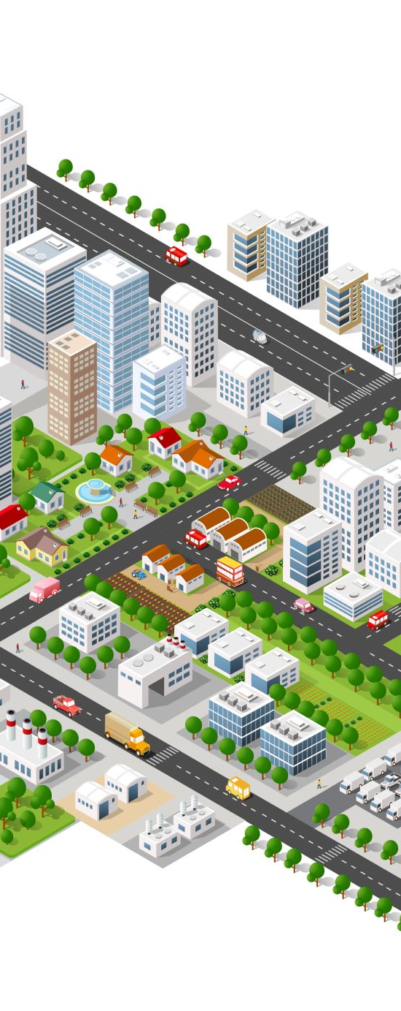
Use available resources – across campus
Center City:
  Center for Academic Success: www.jefferson.edu/studentsuccess
  Library: http://library.jefferson.edu/scott.cfm
  Student Counseling Center: https://www.jefferson.edu/university/academic-affairs/counseling-center.html
  Office of Student Life and Engagement (events and student orgs): https://www.jefferson.edu/university/student-life-engagement.html.html
  Jefferson Wellness Tips: https://www.jefferson.edu/coronavirus/wellness-tips.html
  Jefferson Division of Student Affairs Canvas page (with links to range of services):

Slide 82
Student Panel – representing JCRS…
Carly D’Angelo, OTD
Ella Waddell, OTD
Please share any advice you have about using resources to support learning or wellbeing… or for any other purpose
Do you have any other advice – about anything?

Slide 83
Student Panel – Q and A

Slide 84
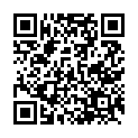
Please complete a brief evaluation
We highly value your feedback and will use it to guide future programming.
Thank you for participating today and good luck in your studies!
https://www.surveymonkey.com/r/QXHG6RR

Slide 85
Center for Academic Success www.jefferson.edu/studentsuccess
Strategic Academic Support Consultations
Time Management
Study Strategies
Learning large amounts of information
Strategic study across the study cycle
Active study strategies
Effective and strategic reading, listening and note-taking
Exam Preparation and exam taking
Writing Consultations @Student Writing Center
One-on-One Consultations
Online Writing Review
www.jefferson.edu/academic_support
www.jefferson.edu/student_writing

