Slide 1
The Academic Success Center
Tutoring Center and Academic Advising Services

Slide 2
Academic Success Center
  Office Description
  Placement Process
    Writing Placement
    Math Placement
    Transfer Credits
  Reading the Schedule
    Decoding the schedule
    Hallmarks and Honors
  Academic Support and Resources
    First Year Advising
    DegreeWorks
    Tutoring Resources
  Important Things to Remember
  Academic Success Center Contact Information
    Staff Introductions

Slide 3
OFFICE DESCRIPTION
We are excited to begin this academic journey with you!
The Academic Success Center provides many forms of Learning Support and Tutoring throughout your student career at Jefferson, including Professional Writing, Math, Science, Design, and Academic Skills, as well as Peer Tutoring for many subjects.
We will also assign your First-Year Academic Advisor closer to the start of term. Your Advisor will reach out to you and introduce themselves within the 1st week of classes; they are faculty members who also teach in your College.

Slide 4
PLACEMENT PROCESSS
As a first-year student, you are enrolled in your first semester courses according to the requirements for your major.
We require that you complete an online Math Test and a Writing Placement Process on Canvas.Jefferson.edu. We can then schedule you into the appropriate level of math for your major and first-year level writing courses.
More info can be found here: https://www.jefferson.edu/east-falls/academic-success-center/placement-tests.html

Slide 5
WRITING PLACEMENT
We use a Directed Self-Placement method for Writing placement– it puts you in charge (with help as needed). You will choose one of the following classes that fits your needs best:
WRIT-100: Intro to Academic Writing
  3 credits
  This will count as a free elective if you have room for it
  Students usually take WRIT-101 after successfully completing WRIT-100
WRIT-101: Writing Seminar 1
  3 credits
WRIT-101S: Writing Seminar 1, Studio: Introduction to Academic Written Communication,
  4 credits
  Comparable to WRIT-101, but moves at a slower pace, requires the writing of 4 assignments as opposed to 5, meets 3 times a week instead of 2.
  The 3rd class session is a studio session that focuses on the conventions of university level writing including: the language of scholarship, critical reading, genre analysis, intensive revision. The studio meeting time is not optional.
All students will then take WRIT-201: Writing Seminar 2
  You may be placed here if you come in with Writing transfer/AP credit.
Notes:
will focus on “academic discourse,” the language of scholarship. Like any other language, academic discourse can be examined, taught, and learned, and we will do so together by examining different kinds of academic discourse, both our own and the academic writing of published authors. Why do we write differently in universities than we write to our friends on social media? What are the markers—the conventions—of writing in a university setting, and what values underscore this language? [Writing Intensive; 3 cr]

Slide 6
Math placement depends on your math placement results, as well as the math requirements for your specific major. Depending on your results you may have been placed into the one of the following:
MATH PLACEMENT
MATH-099: Fundamentals of College Mathematics
  This is a 3 credit course for Financial Aid purposes, but does not go towards graduation requirements
  Students must earn a “C” or better
MATH-100: College Algebra
  3 credits
  Same content as MATH-101 with more dedicated time
MATH-101: College Algebra
  3 credits
MATH-102: Pre-Calculus
  3 credits
  Students must be in Pre-Calculus to be eligible to take CHEM-103/L: Chemistry 1 and Lab
MATH-103: Applied Calculus
  3 credits
MATH-110: Pre-Calculus for Science and Engineers
  4 credits
  A more intensive Pre-Calc for those in majors with extended Math study
  Students must be in Pre-Calculus to be eligible to take CHEM-103/L: Chemistry 1 and Lab
MATH-111: Applied Calculus
  4 credits
  A more intensive Calculus for those in majors with extended Math study and moving into MATH-112: Calculus 2

Slide 7
TRANSFER CREDITS
FAOFILE
Think you already have course credit for Writing or Math?
  We accept Advanced Placement (AP), International Baccalaureate (IB), and/or Dual Enrollment courses.
  Check how your AP Scores would equate: www.jefferson.edu/life-at-jefferson/handbooks/policies/undergraduate-policies/advanced-placement.html
Send your scores to Admissions ASAP!
  Don’t assume your High School sent your AP Scores or College transcripts for you.
Schedule change updates
  We will change your schedule once your official documents have been received, and we will notify you of the change to your university e-mail.
Questions?
  Contact Gina May at Gina.May @Jefferson.edu

Slide 8
YOUR SCHEDULE
How to read the schedule:
  Example: FYS-100-8, T 4-4:50
    First Year Seminar-100- section #8
    Meets on Tuesdays only from 4 p.m. to 4:50 p.m.
Instructors, buildings, and classroom assignments are added closer to the start of the semester
Check your schedule on BannerWeb often for changes!
  Schedules may change, or locations updated.
Class days:
  M- Monday
  T- Tuesday
  W- Wednesday
  R- Thursday
  F- Friday
    You may have classes M/W/F, meaning that class meets every Monday, Wednesday and Friday
    Or, you may have a class that meets only on R, which means you only go to that class on Thursdays

Slide 9
Sample Student Schedule- Accounting
CLASS NAME | COURSE NUMBER | DAYS/TIMES
First Year Seminar | FYS-100-6 | W 1-1:50 p.m.
Writing Seminar I | WRIT-101-15 | MWF 12-12:50 p.m.
Finding and Shaping Opportunity | DECF-102-1 | TR 4-5:15 pm
Principles of Marketing | MKTG-102-9 | TR 9:30-10:45 a.m.
College Algebra | MATH-101-3 | TR 11-12:15 p.m.
Financial Accounting | ACCT-101-1 | MW 8-9:15 a.m.

Slide 10
Sample Student Schedule- Pre-Med
CLASS NAME | COURSE NUMBER | DAYS/TIMES
First Year Seminar | FYS-100-25 | R 11-11:50 a.m.
American Visions | AVIS-101-1 | TR 9:30-10:45 a.m.
Pre-Calculus | MATH-110-5 | MWF 1-1:50 p.m.
Biology I | BIOL-103-7 | MWF 9-9:50 a.m.
Biology I Lab | BIOL-103L-2 | R 6:30-9:15 p.m.
Chemistry 1 | CHEM-103-1 | MWF 11-12:10 p.m.
Chemistry I Lab | CHEM-103L-4 | T 7-9:45 p.m.

Slide 11
Sample Student Schedule- Architecture
CLASS NAME | COURSE NUMBER | DAYS/TIMES
First Year Seminar | FYS-100-3 | R 11-11:50 a.m.
Writing Seminar I | WRIT-101-2 | TR 8-9:15 a.m.
Landscape Ecology | SCI-110-1 | F 8:30-9:30
Landscape Ecology Lab | SCI-110L-1 | F 9:40-11:30
Pre-calculus | MATH-102-7 | TR 4-5:15 p.m.
Drawing I | ARFD-103-2 | MW 8:00-8:50 a.m.
Design I | ARFD-101-1 | MW 9:00-12 p.m.
Topics in the Built Environment | ARFD-104-1 | R 6-6:50 p.m. (online)

Slide 12
Sample Student Schedule- Fashion Design
CLASS NAME | COURSE NUMBER | DAYS/TIMES
First Year Seminar | FYS-100-3 | W 4-4:50 p.m.
Writing Seminar I | WRIT-101-2 | TR 8-9:15 a.m.
Fashion Design Research | FASD-252-4 | MW 10-12:15 p.m.
Drawing Essentials | DRAW 101-1 | TR 10-12:15 p.m.
Survey of Textile Industry | TEXT 101-2 | MW 8-9:15 a.m.
Systems Thinking & Sustainability | DECS 209-7 | MW 2:30-3:15 p.m.

Slide 13
DECODING THE SCHEDULE
FAOFILE
Gaps are the norm with college schedules. Students with time gaps use this time to study, finish assignments or participate in extracurricular activities.
Use the Course Catalog to look up course descriptions and learn course abbreviations - http://www.eastfalls.jefferson.edu/catalog/CourseDescriptions/index.aspx
You are in a First-Year Seminar (FYS) course
  All incoming freshman will participate in the FYS Course. This course meets once a week and is an opportunity to learn and practice strategies that will enable their success in college. Students will create personal, professional, and academic goals, as well as success strategies for learning and career development.
Notice that you are expected to take courses in your major immediately.
You will work with your first-year advisor to create a semester plan for every semester following your first.

Slide 14
HALLMARKS
Hallmarks Program
You should be enrolled in at least one Hallmarks Gen Ed course
General education at Jefferson focuses on eight key qualities that are essential for your personal and professional success. Our Hallmarks Program identifies and develops these qualities as you advance through your major, your general education core curriculum (the Hallmarks Core), and your co-curricular activities (internships, study abroad, student organizations, etc.), preparing you to be a leader in your field.
With the goal of imagining and realizing better futures, the Hallmarks Program at Jefferson empowers students to:
  Question based on curiosity and confidence
  Adapt based on contextual understanding and global perspective
  Contribute based on empathy and collaboration
  Act based on initiative and ethical reflection
For more information, please visit: https://www.jefferson.edu/university/hallmarks-program.html

Slide 15
COURSE EXAMPLES
DegreeWorks
DegreeWorks will track the academic progress and list all of the courses students need to complete their program and graduate.
On DegreeWorks students can click on the blue hyperlink of select courses to view the description, section availability and any prerequisites needed for that course.
For example, if students click on the link for “Math 102” they will see the class description and that the minimum grade needed to take the class is a D in Math 100 or Math 101.
DegreeWorks includes Class History, how transfer credits are applied and a planning worksheet where students and advisors can create potential class plans for future semesters.
Student can also use the “What-If” feature on Degreeworks to review what their progress and requirements would be if they changed their major.
DegreeWorks can be accessed through BannerWeb.

Slide 16
FIRST-YEAR ADVISING
You will be assigned a First-Year Advisor
  Advisors are both faculty members and academic advisors.
  Advisors are assigned by major and are proactive in outreach to students.
  Student begin immediately with a professional contact in their area of interest.
  Advisors guide students in course planning, goal setting, and making responsible choices for their academic careers.
Drop/Add
  Advisors assist students with dropping courses and adding them, especially in the first semester when the advisor’s signature is required to make changes.
  Students can speak with their advisor about schedule changes.

Slide 17
FIRST-YEAR ADVISING
Starfish
  Starfish assists with the adjustment to college– it is a way for your faculty to let you know if they have concerns about your progress in your courses or give you kudos when you are succeeding.
  Advisors utilize the Starfish early alert/kudos system.
Jefferson Student Portal
  Access student resources such as: email account, financial aid, account balance, schedule and information for University offices.
  Login with your Jefferson Campus Key and password.
  There is an app available on the Apple Store and Google Play as “Jefferson Student Portal”
  More info at studentportal.jefferson.edu

Slide 18
TUTORING CENTER
Writing
Professional Writing Tutors are available for 1:1 appointments
Workshops are also frequently offered for students
  Workshop topics include: Navigating Tech Systems, Avoiding Plagiarism, Paraphrasing and Research Strategies, and Active Reading for Writing Purposes
Math
Professional and Peer Tutors available for 1:1 appointments
Study Groups and Professional Drop-in Tutoring available for all math courses
Content Areas
Peer and Professional Tutors available for the majority of subjects
Academic Success Strategies
1:1 tutoring and workshops are available to build learning skills
  Workshop topics include: Time Management, Study Skills, Organizational Skills, Note Taking, Reading Strategies and more!
Tutoring is available throughout your entire academic career at Jefferson. For more information, please visit: http://www.eastfalls.jefferson.edu/successcenter/index.html

Slide 19
IMPORTANT THINGS TO REMEMBER
Student Accommodations:
  Register with the Office of Accessibility Services if eligible
  https://www.jefferson.edu/east-falls/student-accessibility-services.html
Student Athletes:
  You are expected to give your professors a copy of your athletic schedule to work out any issues in advance.
  Never miss a class for practice!
University Calendar:
  Classes begin: Wednesday, January 8
  Last day to ADD:
  Wednesday, January 15
  Last day to DROP: Friday, January 17
  http://www.eastfalls.jefferson.edu/registrar/calendar/index.html
University e-mail:
  Begin checking your Jefferson University e-mail.
  All communication from Jefferson, including schedule updates, will come through your university email account.

Slide 20

Lauren-Elise Kadel
ACADEMIC SUCCESS CENTER – REGISTRAR – FINANCIAL AID – STUDENT ACCOUNTS – STUDENT HEALTH – LIBRARY- AND MORE

Slide 21
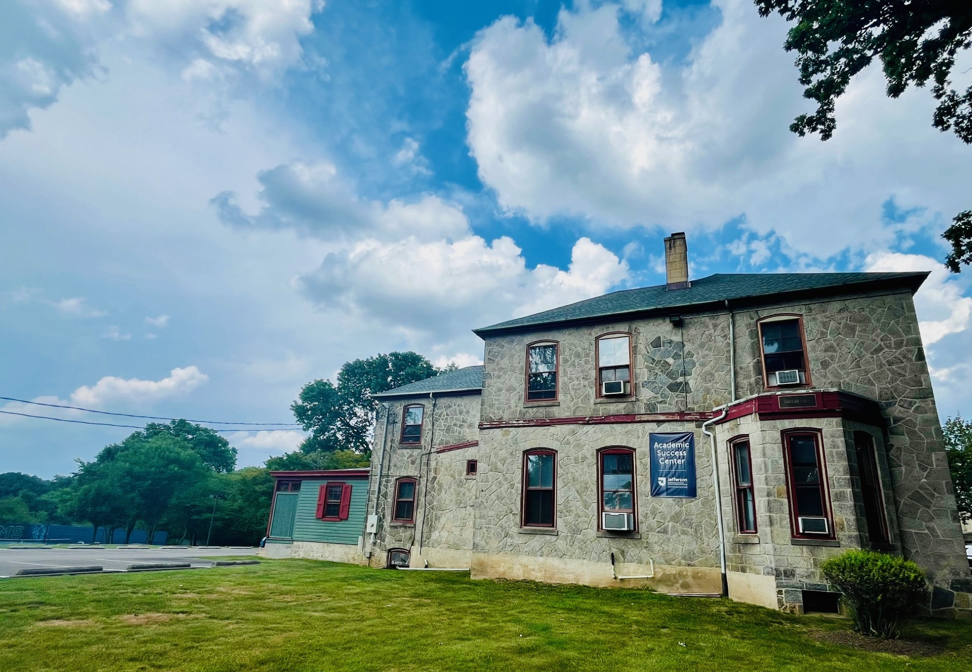
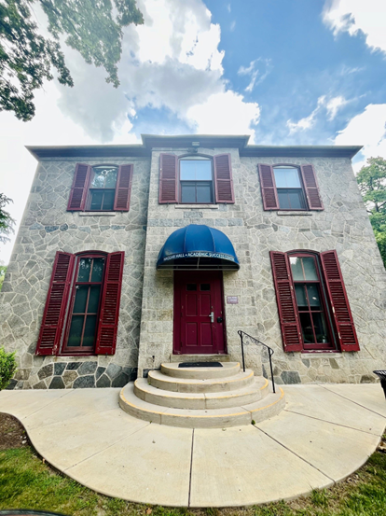
ACADEMIC SUCCESS CENTER CONTACT INFORMATION
TUTORING
  Haggar Hall, 1st floor
  Monday – Thursday, 9 a.m. – 8 p.m.
  Fridays, 9 a.m. – 5 p.m.
  Weekend Hours available
  Tutoring begins Week 2 of the semester
  TJU_EF_Tutoring@Jefferson.edu
  215-951-2799
FIRST YEAR ADVISING
  Haggar Hall, 2nd floor
  Monday – Friday, 9 a.m. – 5 p.m.
  TJU_EF_Advising@Jefferson.edu
  215-951-2799
Schedule Advising or Tutoring Appts by logging into STARFISH

