Slide 1


Concur Travel and Expense Management
Employee Profile Configuration
Travel Preferences
Email Preferences

Slide 2
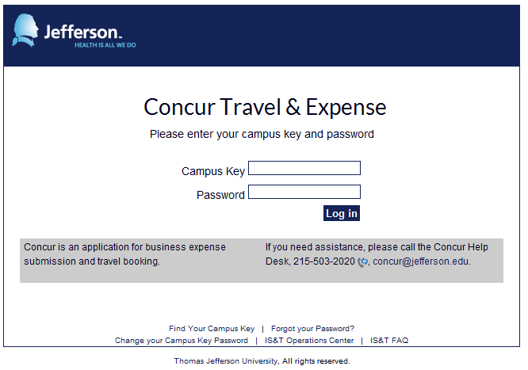
  Navigate to Concur at Concur.Jefferson.Edu, from anywhere
  Sign on using your campus key and password

Slide 3
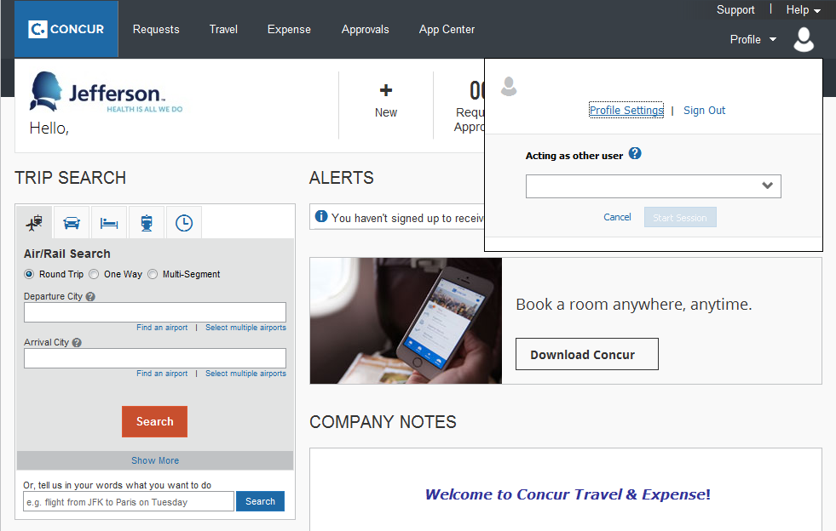
  Click on Profile
  Click on Profile Settings

Slide 4
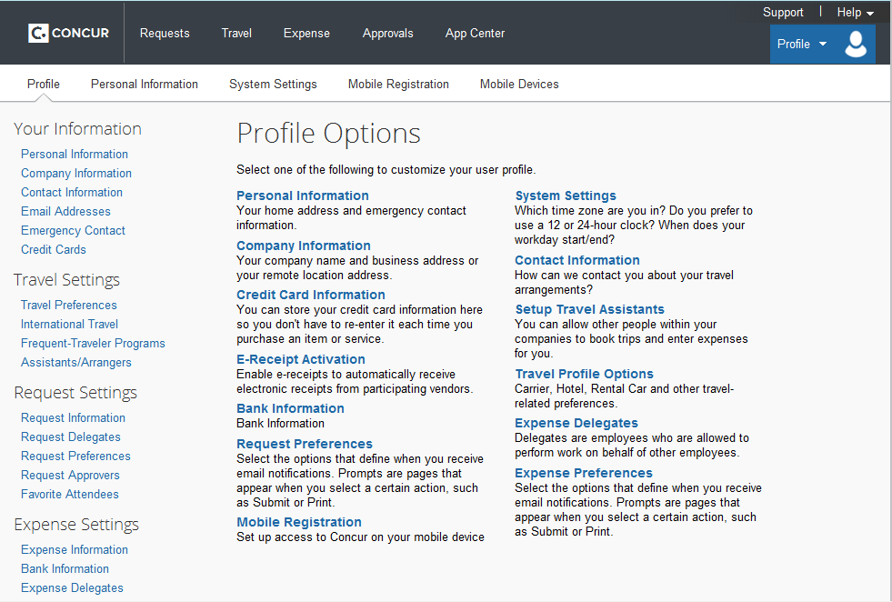
  Click on Personal Information

Slide 5
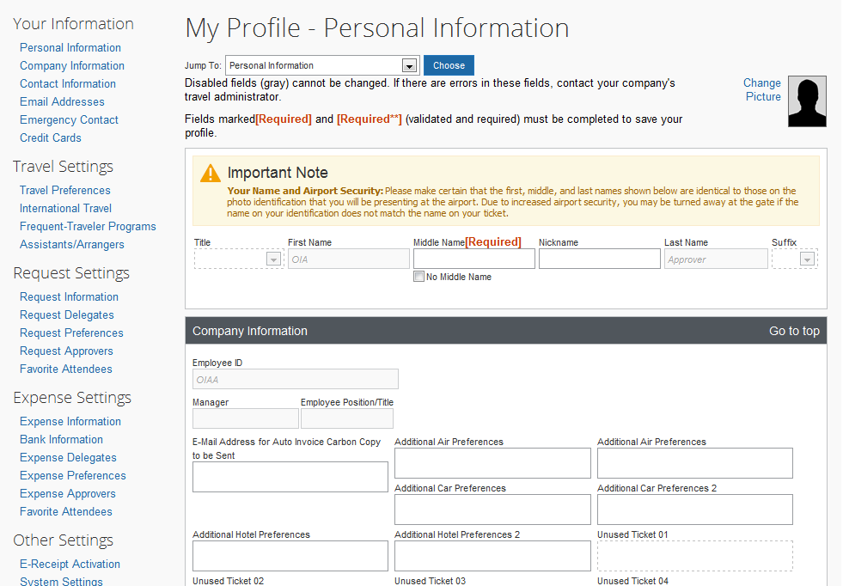
  Example – My Profile – Personal Information
  Enter your middle name, as it appears on the government-issued ID you will use to travel.
    If your ID bears only a middle initial, enter that.
    If you do not have a middle name, click the No Middle Name check box.

Slide 6
  Example – My Profile – Personal Information
  No action required
  Information in gray text has been pre-populated from Jefferson HR records.
    If information is incorrect, correct the information in HR self-service and your Concur profile will update the following day.

Slide 7
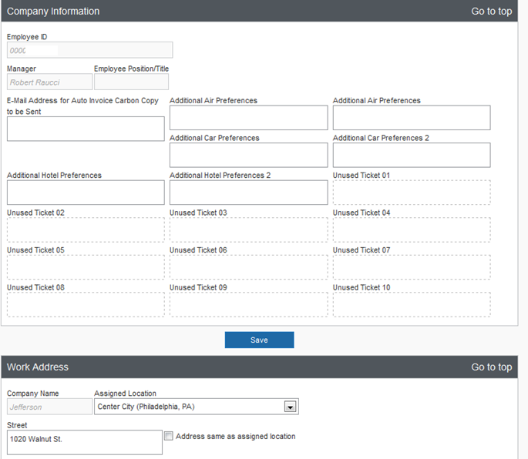
  Example – My Profile – Personal Information
  No action required

Slide 8
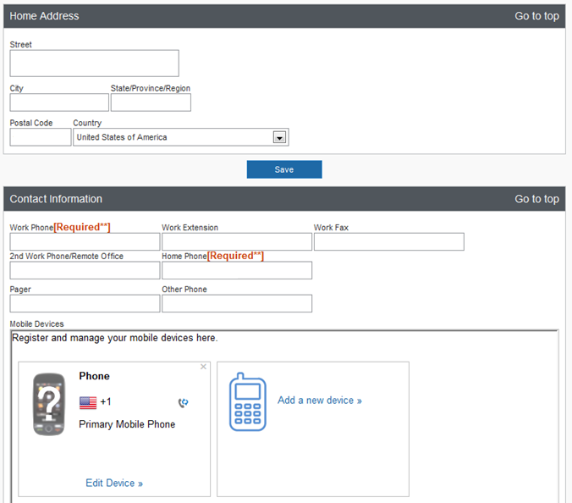
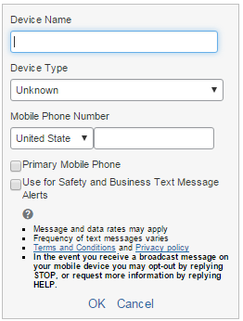
  Example – My Profile – Personal Information
  Enter your work and home phone numbers.
  A mobile phone number is not required.
  If adding a mobile phone, click on Add a new device >> and enter a “nickname” for your phone in the Device Name field, select the manufacturer and enter your phone number.
  Click OK
  No action required

Slide 9
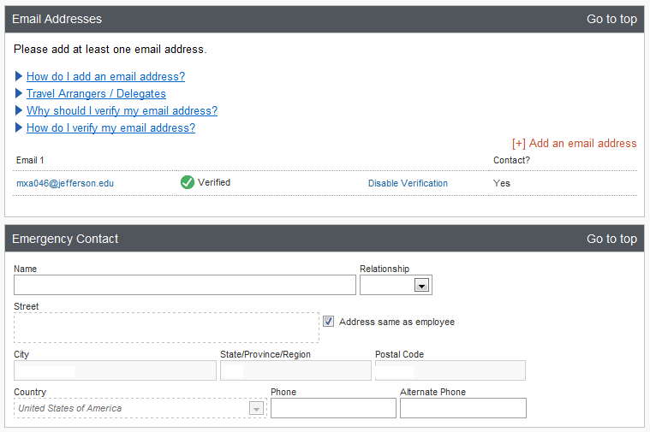
  Example – My Profile – Personal Information
  Add and verify your Jefferson email address
  No action required – information is on file with Jefferson HR

Slide 10
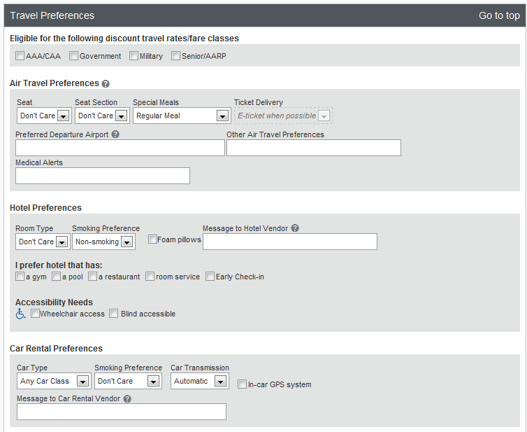
  Example – My Profile – Personal Information
  If you qualify for any of these discounts, check the corresponding box(es).
  You may enter air/hotel/car rental preferences, but this information is not required

Slide 11
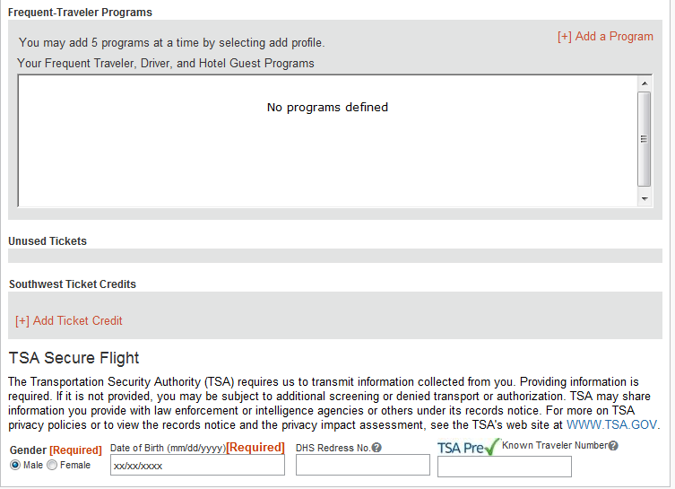
  Example – My Profile – Personal Information
  You may still earn frequent flyer/traveler awards when booking through Concur
  Click [+] Add a Program and enter the appropriate information
  Select your gender and fill in your date of birth
    Date of birth will be masked (xx/xx/xxxx) upon saving
  If you have a TSA Precheck known traveler number, you may enter it here

Slide 12
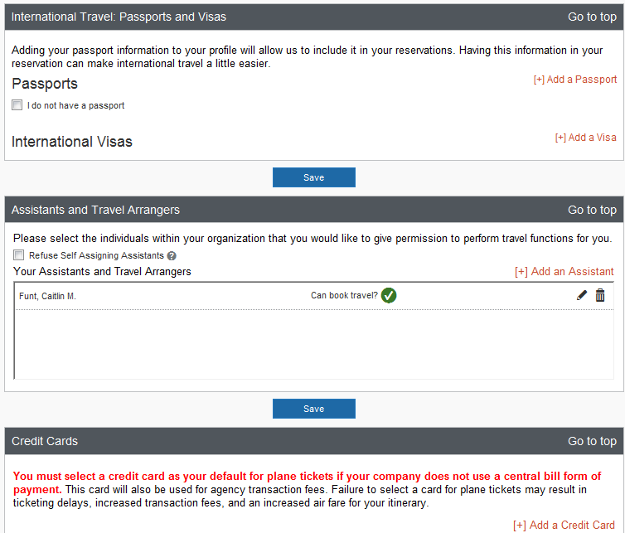
  Example – My Profile – Personal Information

Slide 13
  Configuring Individuals to Arrange Travel on your Behalf
  Click on Assistants/ Arrangers

Slide 14
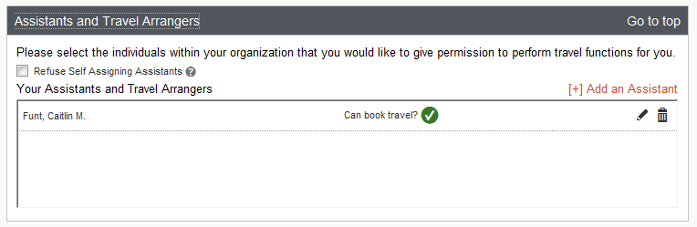
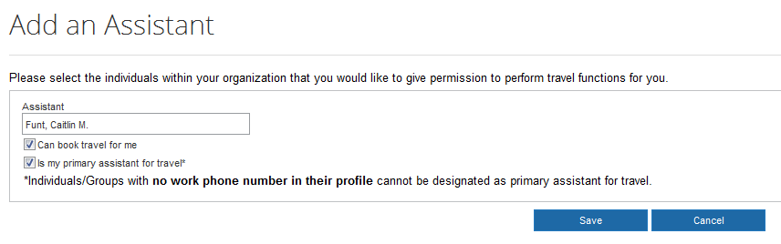
  Configuring Individuals to Arrange Travel on your Behalf
  Click on [+] Add an Assistant
  A popup window will appear
  Enter travel arranger’s last name in the search box
  Check the appropriate boxes
  Click SAVE

Slide 15
  Configuring System Email Preferences
  Click on System Settings

Slide 16
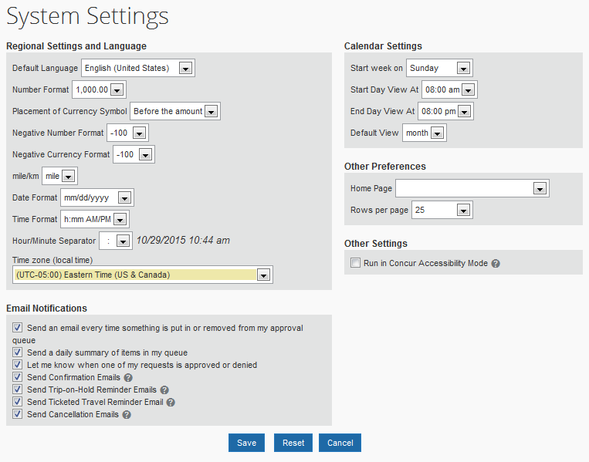
  Configuring System Email Preferences
  Indicate when you would (not) like to receive system-generated emails
    Uncheck boxes to stop corresponding email notifications.

Slide 17
  Configuring Individuals to Prepare, Submit, Review or Approve on your behalf
  Click on Expense Delegates

Slide 18
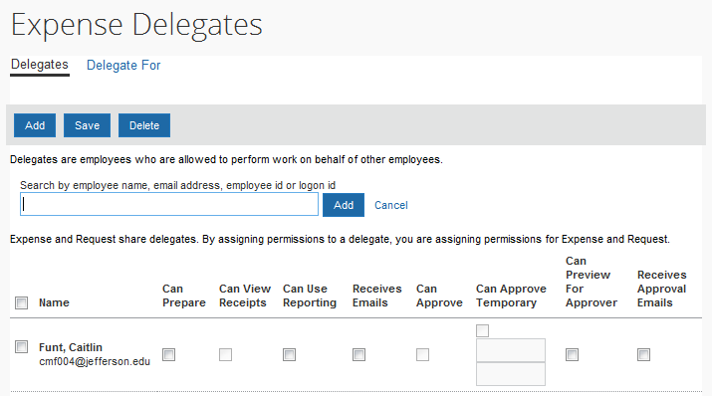
  Configuring Individuals to Prepare, Submit, Review or Approve on your behalf
  Click Add
  Begin typing the employee’s name
  Click Add
  Select the functions you would like the individual to perform on your behalf.
    Permissions may be restricted by HR job role
  Click Save

