Slide 1
Concur Travel and Expense Management
Acting as Other Users:
  Accessing accounts that have been delegated to you.

Slide 2
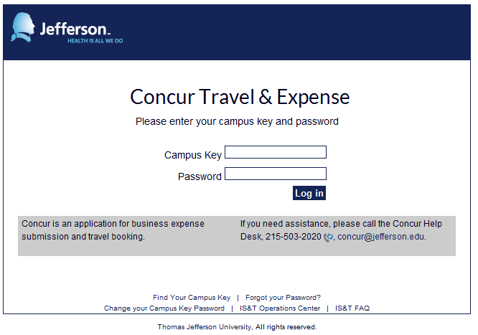
  Navigate to Concur at Concur.Jefferson.Edu, from anywhere
  Sign on using your campus key and password

Slide 3
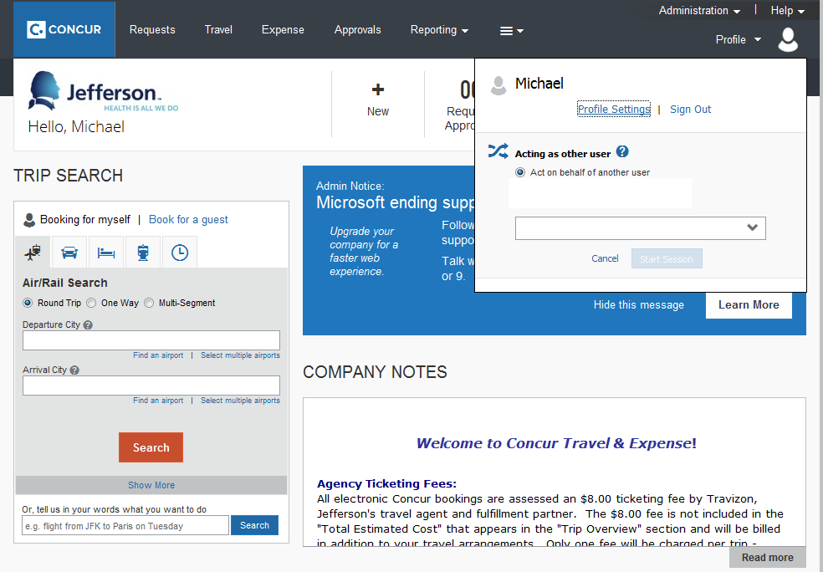
  Click on Profile
  Click in the box under the Acting as other user heading

Slide 4
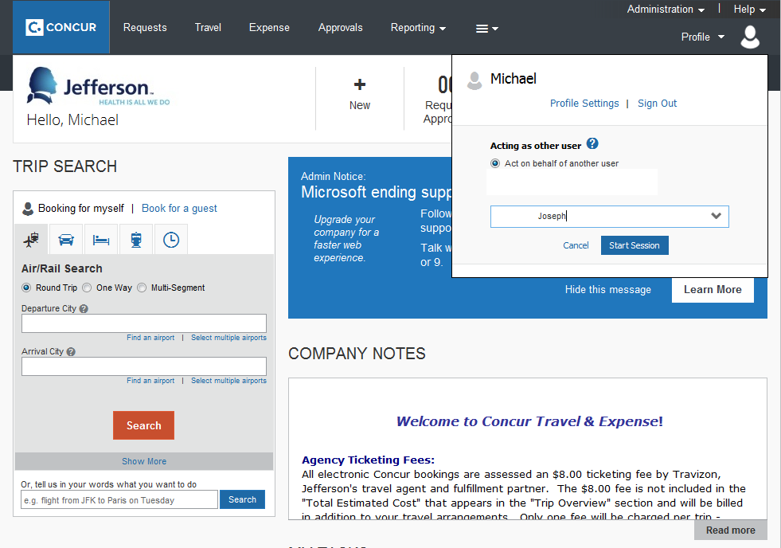
  Select the user for whom you wish to work on behalf of
    You will only be able to access profiles of individuals who have configured you inthe profiles.
  Click Start Session

Slide 5
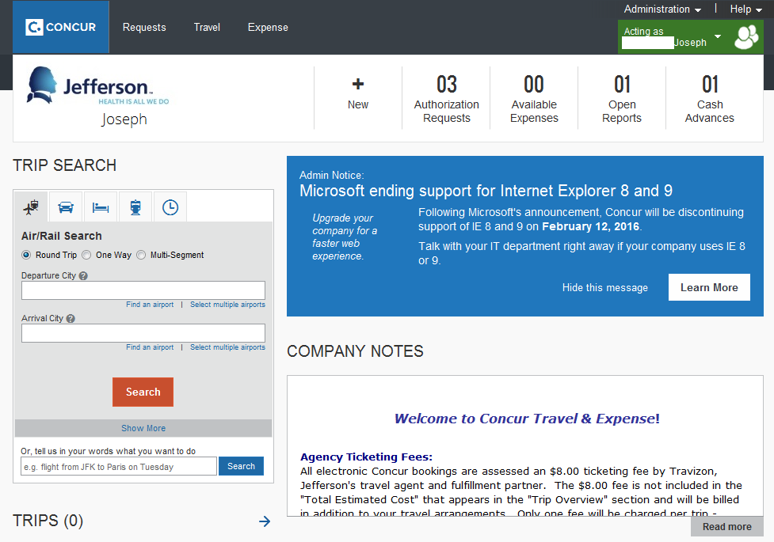
  When successfully in another’s profile, the icon at the top right of your Concur screen will change from one person to two and the area will be highlighted in green and read, Acting as _________.
  Every action performed will be logged by the user, on behalf of the delegee.

