Slide 1


Concur Travel and Expense Management
Delegate Configuration:
  Configuring Individuals to Prepare, Submit, Review or Approve on your behalf

Slide 2
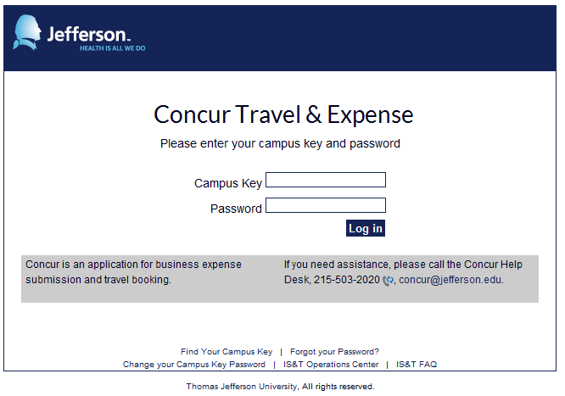
  Navigate to Concur at Concur.Jefferson.Edu, from anywhere
  Sign on using your campus key and password

Slide 3
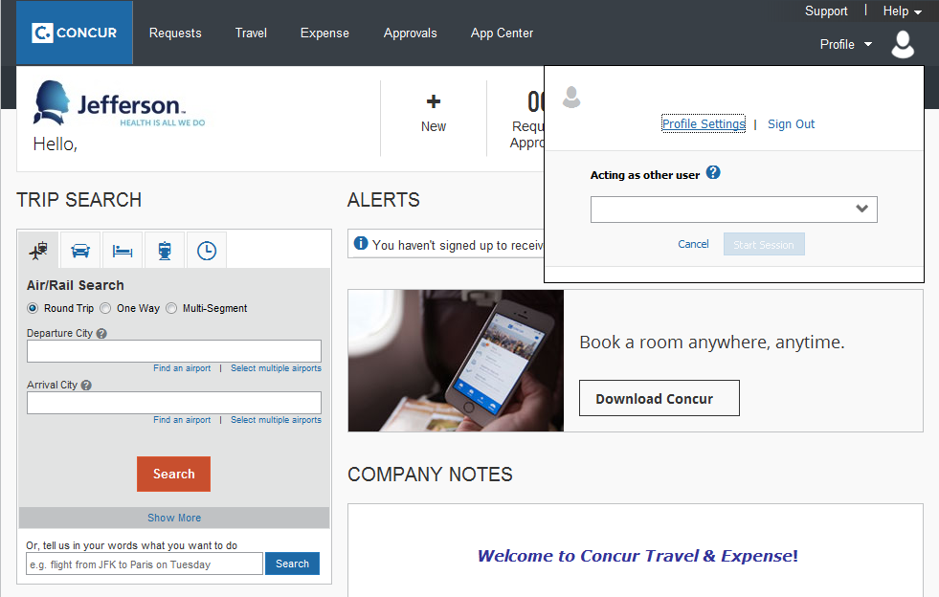
  Click on Profile
  Click on Profile Settings

Slide 4
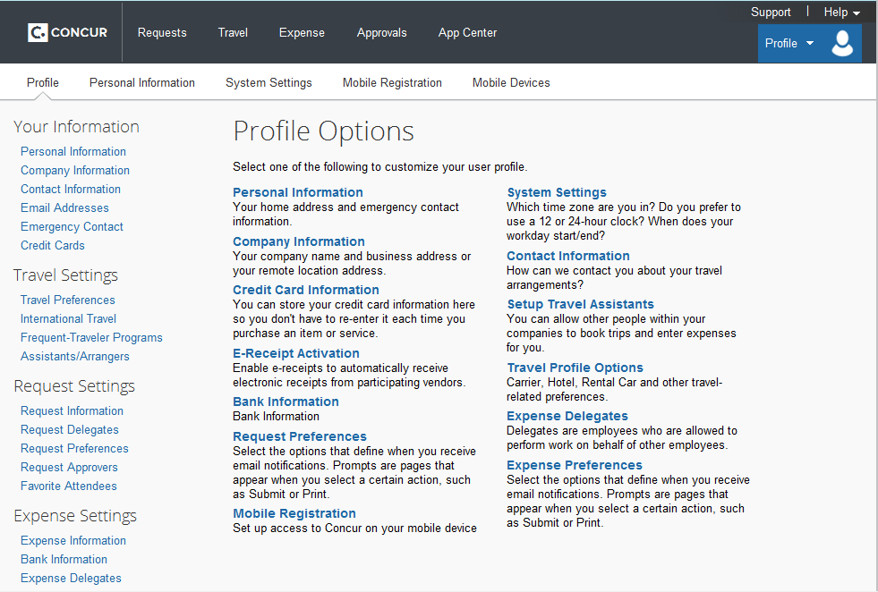
  Click on Expense Delegates

Slide 5
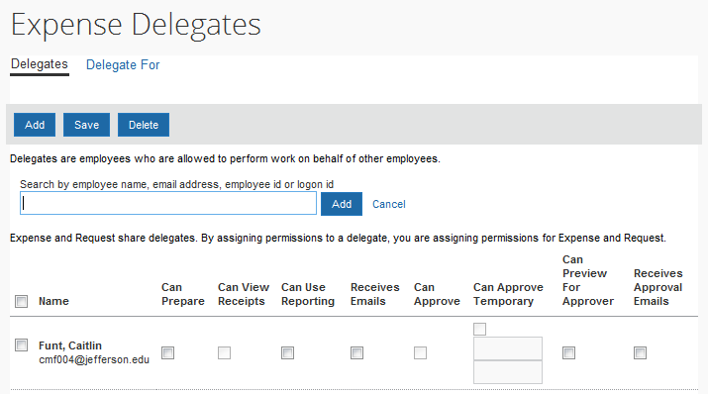
  Click Add
  Begin typing the employee’s name
  Click Add
  Select the functions you would like the individual to perform on your behalf.
    Permissions may be restricted by HR job role
  Click Save

