Slide 1
PAYING YOUR BILL AT THOMAS JEFFERSON UNIVERSITY

Slide 2

Ways To Pay Your Bill
Pay Online
Pay by:
Debit Card
Credit Card
E-Check
At Banner Web
https://banner.jefferson.edu
International Wires
Wells Fargo Bank
Philadelphia, PA
ABA # 121000248
To Credit TJU Corporate Account
Account # 2000049155914
Swift Code WFBIUS6S
*Please reference your campus key in any note section of your wire payment
Pay by Mail
Mailing Address for sending a money order, personal check, 529 check or any other check:
Mail to:
Thomas Jefferson University
1101 Market Street
29th Floor
Philadelphia, PA 19107
Your cancelled check is your receipt.
Student’s Jefferson account will be charged $25 if the check is returned from the bank.
Return reasons include: insufficient or unavailable funds, stop payment, closed account, questionable or missing signature, etc.
Pay in Person
Pay by:
Personal Check
Money Order
Cash
Visit:
Thomas Jefferson University
1101 Market Street
29th Floor
Philadelphia, PA 19107
215-503-7669
*Please call in advance to ensure someone is available to help you
*Please reference the students campus key on the memo line of your check/money order

Slide 3
How To Pay Your Bill Online
Log onto Banner Web – https://banner.jefferson.edu using your current Banner campus key and password.
Click “Student” tab
Click “Student Account” link
Click “Make Payment/View Invoice” link
You will be directed to TouchNet, our secure payment gateway provider, to view your balance, see your bill or make a payment.
Refer to the following slides for how this looks in Banner and TouchNet.

Slide 4
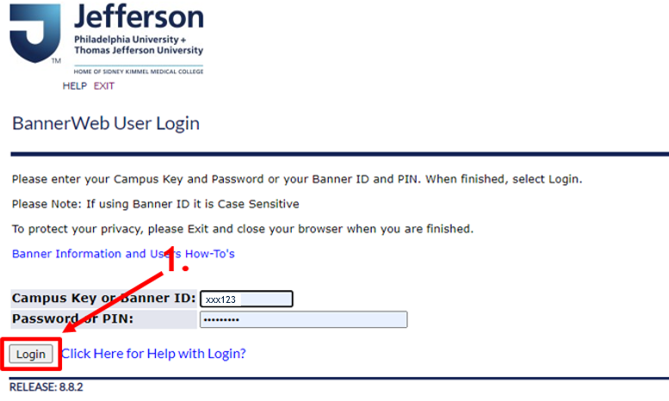
How To Pay Your Bill Online

Slide 5
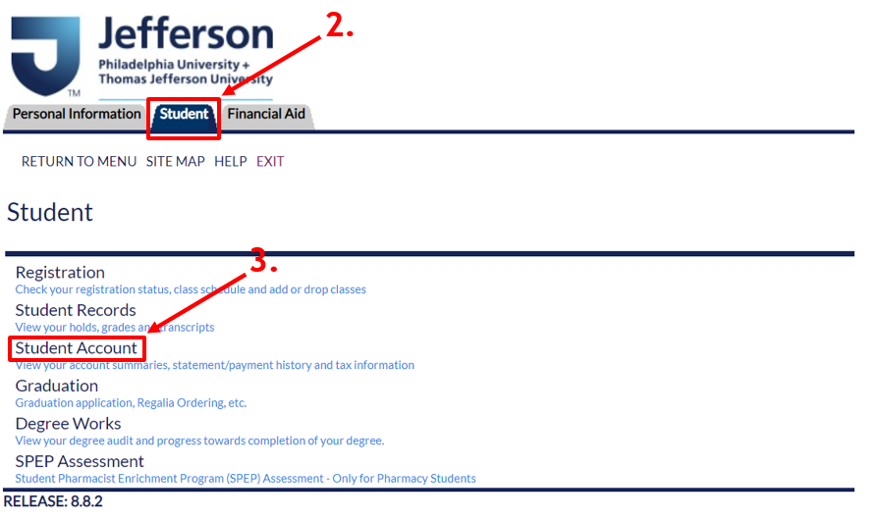
How To Pay Your Bill Online

Slide 6
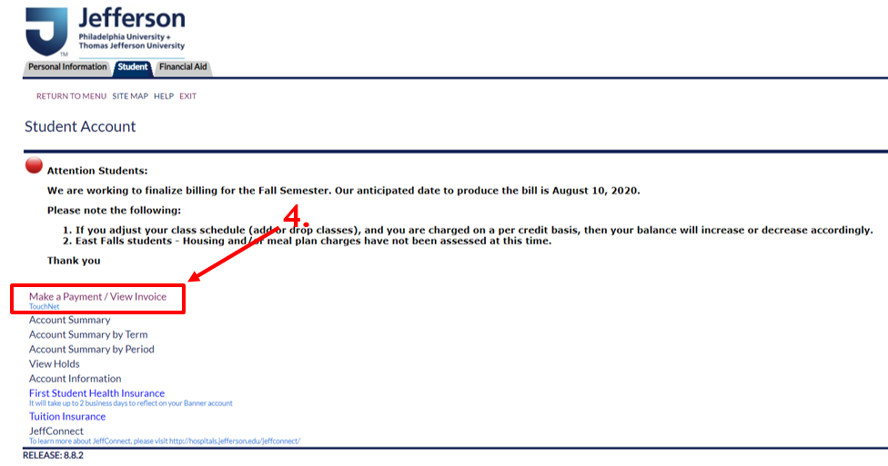
How To Pay Your Bill Online

Slide 7
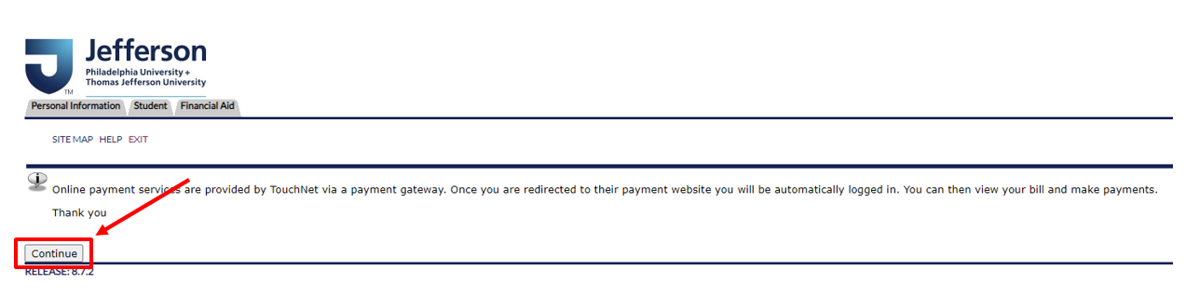
How To Pay Your Bill Online

Slide 8
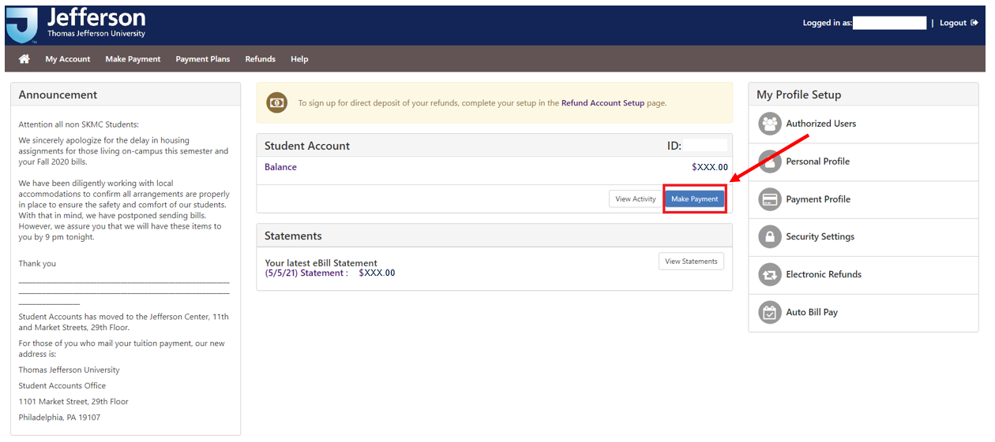
How To Pay Your Bill Online

Slide 9
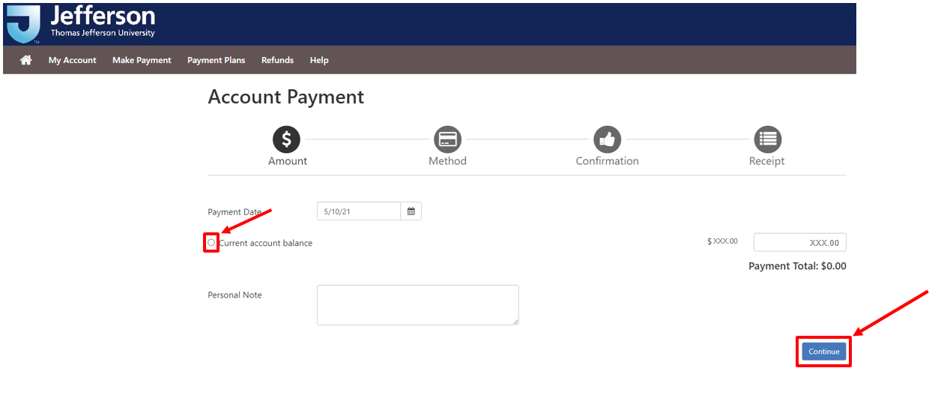
How To Pay Your Bill Online

Slide 10
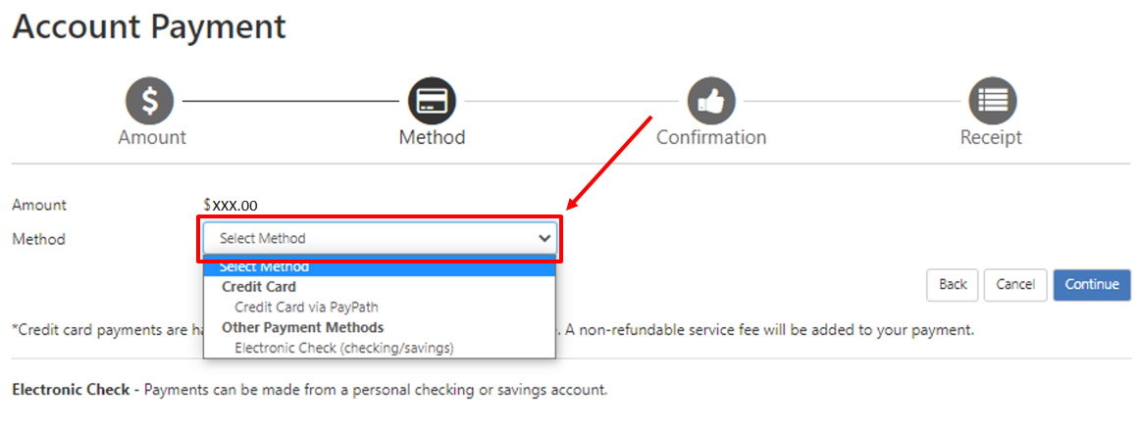
How To Pay Your Bill Online

Slide 11
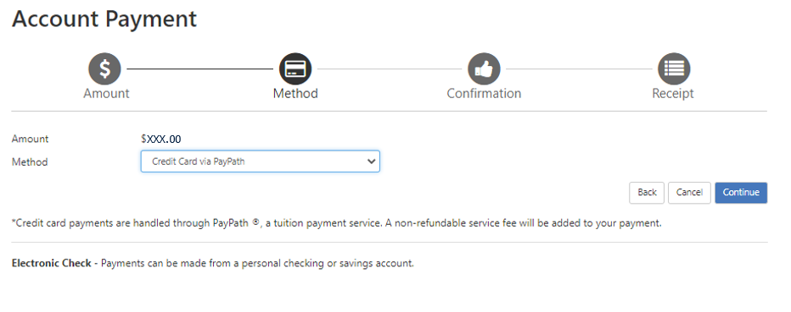
How To Pay Your Bill Online – Credit Card

Slide 12
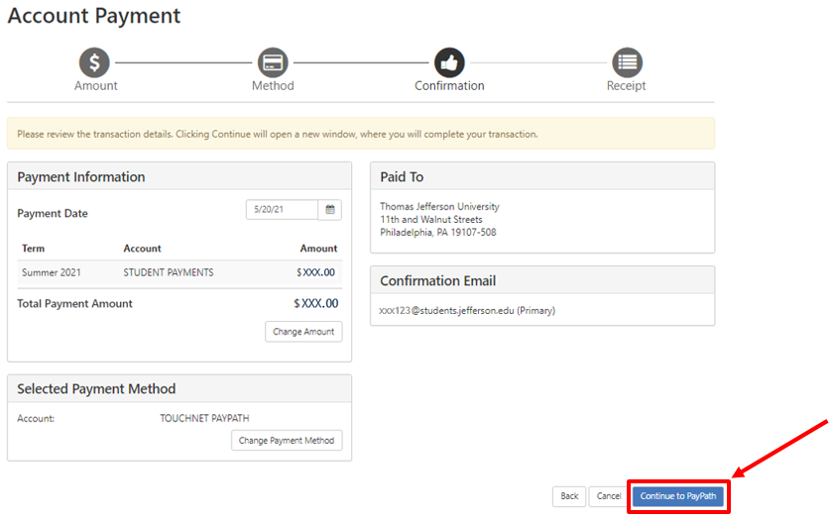
How To Pay Your Bill Online – Credit Card
*Please note a non-refundable PayPath service charge will be added to your credit card payment

Slide 13
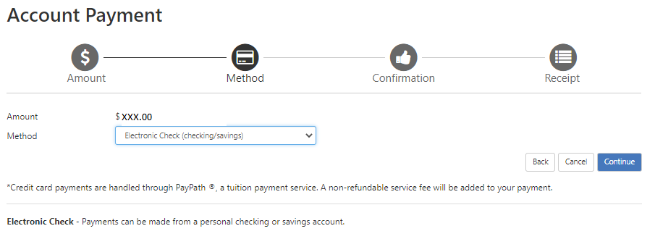
How To Pay Your Bill Online – Electronic Check

Slide 14
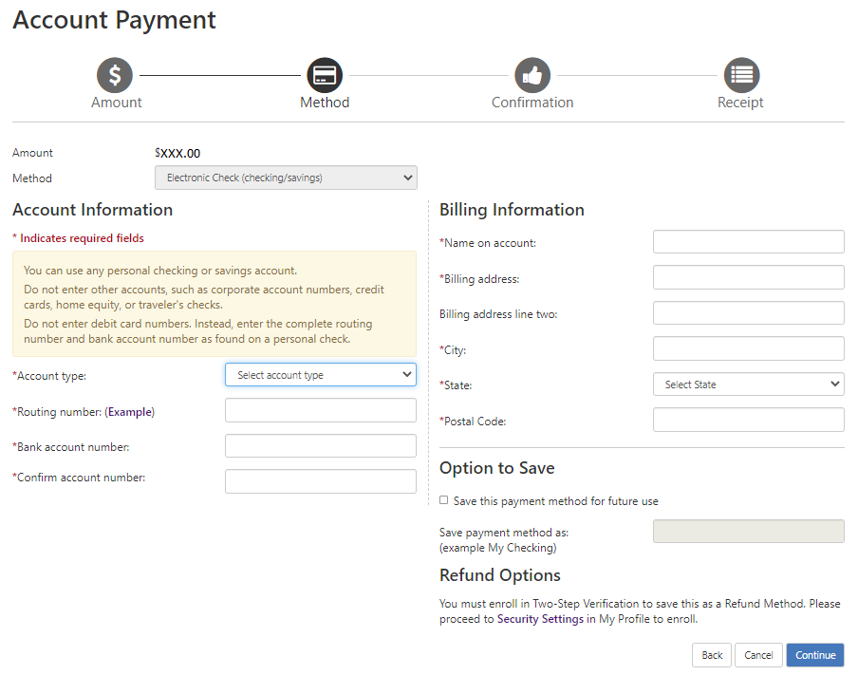
How To Pay Your Bill Online – Electronic Check

Slide 15
Third Party Payments
A Third Party Payment is when Thomas Jefferson University bills an outside organization/company for all or a portion of a student's tuition and/or fees.
Employer paying your tuition directly to TJU? | Please email tuition.office@jefferson.edu with an approved voucher or letter for each semester.
Paying via a 529 Check? | Please have check mailed to TJU (refer to address on Slide 2) for all paper payments, and be sure to include your campus key on the check.
Paying via approved Tuition Payment Plan offered by TJU? | Please email tuition.office@jefferson.edu for plan information. TJU is in the process of finalizing payment plans.

Slide 16
Applying Loans And Scholarships To Your Bill
Financial Aid is disbursed each semester to coincide with the assessment of tuition and other charges.
Most programs are assessed charges for fall and spring only. (refer to slide 18 for exceptions)

Slide 17
Applying Loans And Scholarships To Your Bill
 | Fall |  | Spring
University charges and financial aid | First week of July | Fall charges are assessed | First week of December | Spring charges are assessed
 |  | Fall half of student financial aid will be applied to the bill as a payment or pending aid “memo”* |  | Spring half of student financial aid will be applied to the bill as a payment or pending aid “memo”*
 |  | Bills are sent to students |  | Bills are sent to students
Expiration of memos | December 1 | All remaining fall memos will expire. A bill for the amount of the expired memo will be produced and emailed to student for payment and/or issue resolution. | April 1 | All remaining fall memos will expire. A bill for the amount of the expired memo will be produced and emailed to student for payment and/or issue resolution.
*A memo is a placeholder for expected funds that have not yet been received. Memos are most commonly used to show pending federal and state aid that is not permitted to be disbursed until closer to the first day of the semester.

Slide 18
When Financial Aid Is Not Disbursed In Fall And Spring
The disbursement of aid will occur more than two times to coincide with programs of study that are assessed tuition in each of the fall, spring, and summer semesters or another non-traditional manner.
  Financial Aid is disbursed each semester to coincide with the assessment of tuition and other charges.
  Programs that have more than two tuition assessments/financial aid disbursements include, but not limited to:
      FACT1 Nursing
      DPT – Physical Therapy
      most programs assessed tuition on a per credit basis
The disbursement of aid may occur less than two times if eligibility for future disbursements has been exhausted.
Outside entity (e.g., Rotary Club Scholarship) only sends funding for one term.

Slide 19
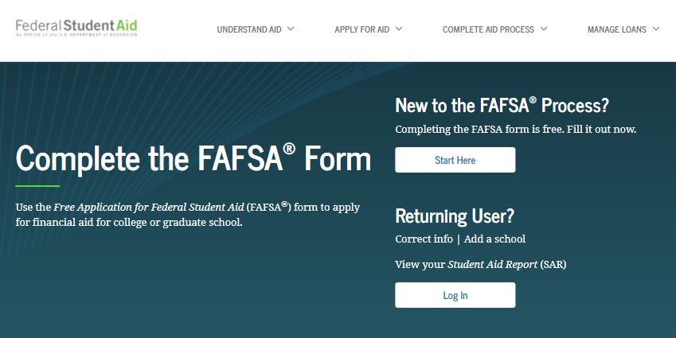
How Do I Apply For Financial Aid To Help Pay My Bill?
To apply for federal, university, state and most private funds, the FAFSA (Free Application for Federal Student Aid) is required.
Thomas Jefferson University school code is 013549.

Slide 20
How To Apply For Financial Aid To Help Pay Your Bill
  Complete the FAFSA electronically:
  On the web: https://studentaid.gov/h/apply-for-aid/fafsa
  Mobile app – Download the myStudentAid Mobile app in the Apple App Store (iOS) or Google Play (Android). Use the myFAFSA component.
  Use the IRS Data Retrieval Transfer (DRT) process when completing the FAFSA. This will streamline and expedite the processing of your financial aid.
  If you have a question while completing the FAFSA, call the federal processor at 1-800-433-3242. The FAFSA Processor has scheduled hours 7 days a week.

Slide 21
Options For Paying Your Remaining Bill
Options for paying the remaining balance after financial aid is applied:
  Payment Plan – Please contact tuition.office@jefferson.edu for plan information. TJU is in the process of finalizing payment plans.
  Federal Parent PLUS Loan – Parents of dependent undergraduate students may apply for this credit-based loan to assist in meeting student’s financial needs. For more information and to apply, click HERE.
  Federal Graduate PLUS Loan – Graduate students may apply for this credit-based loan to assist in meeting financial needs. For more information and to apply, click HERE.

Slide 22
Options For Paying Your Remaining Bill
(continued options)
  Private Educational Loan – The option for students to borrow a credit–based private educational loan (with a credit worthy co-signer) may be available. It is highly suggested that students utilize federal loans first. For more information and to apply, click HERE.
  Private Scholarship Search – Check our Financial Aid websites for information on programs and searches.
    Click here for East Falls (Including students at the JCN Dixon/Horsham site)
    Click here for Center City (Including students at the Voorhees/NJ, Bucks/PA,
      JIB-Spring House/PA sites)

Slide 23
Options For Paying Your Remaining Bill
(continued options)
  Home Equity Loan – A home equity loan is a fixed-rate loan secured by your home. If you qualify for a home equity loan right now, you may find that interest rates are relatively low. Exact interest rates will vary by lender and your credit score.
  Borrow From Family – Create an agreement with a family member to invest in your future with a school loan with agreed upon repayment parameters.

Slide 24
What Happens If You Don’t Pay An Outstanding Balance
If your outstanding balance is not satisfied by the dates below, it will result in the following:
Fall 2021 | Spring 2022 | Summer 2022 | Delinquency Outcomes
October 1 | February 1 | June 1 | Monthly late fee of $100 will be applied to your student account until the outstanding balance has been reduced to less than $500.
October 15 | February 15 | June 15 | Loss of access to the Canvas Learning Management system. This may mean inability to complete assignments and take exams, which may affect your grades and progression.
November 1 | March 1 |  | Loss of access to register for the upcoming term, loss of access to specified campus facilities, inability to obtain a transcript, diploma and participate in the Commencement ceremony.
 |  | July 1 | Cancellation of registration for the upcoming term, loss of access to specified campus facilities, and inability to obtain a transcript or diploma.

Slide 25
Student Account And Financial Aid Contacts
CENTER CITY Students
(Including students at the JCN Dixon/Horsham site)
Student Accounts Office
Email: tuition.office@jefferson.edu
Phone: 215-503-7669
Financial Aid Office
Website: http://jefferson.edu/financialaid
Email: financial.aid@jefferson.edu
Phone: 215-955-2867
EAST FALLS Students
(Including students at the Voorhees/NJ, Bucks/PA,
JIB-Spring House/PA sites)
Student Accounts Office
Email: tuition.office@jefferson.edu
Phone: 215-951-2708
Financial Aid Office
Website: http://eastfalls.jefferson.edu/financialaid/
Email: financialaid@jefferson.edu
Phone: 215-951-2940

