Slide 1
Concur Travel and Expense Management
Mobile Application - iPhone

Slide 2
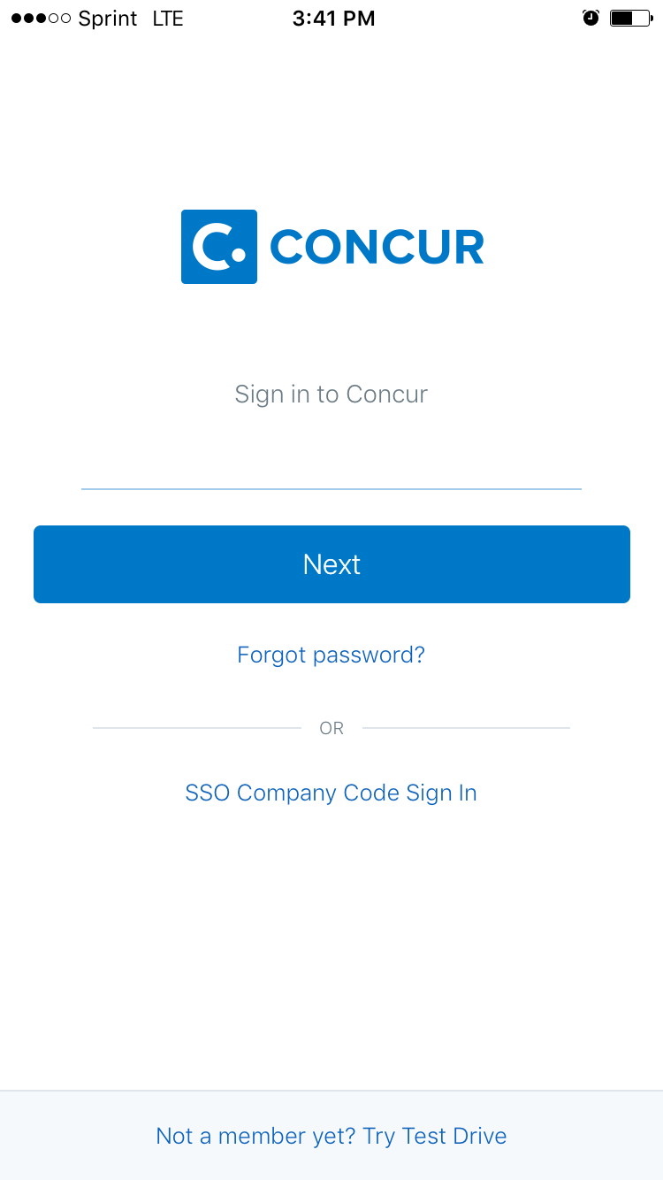
Open the Concur Mobile App
Click on SSO Company Code Sign In

Slide 3
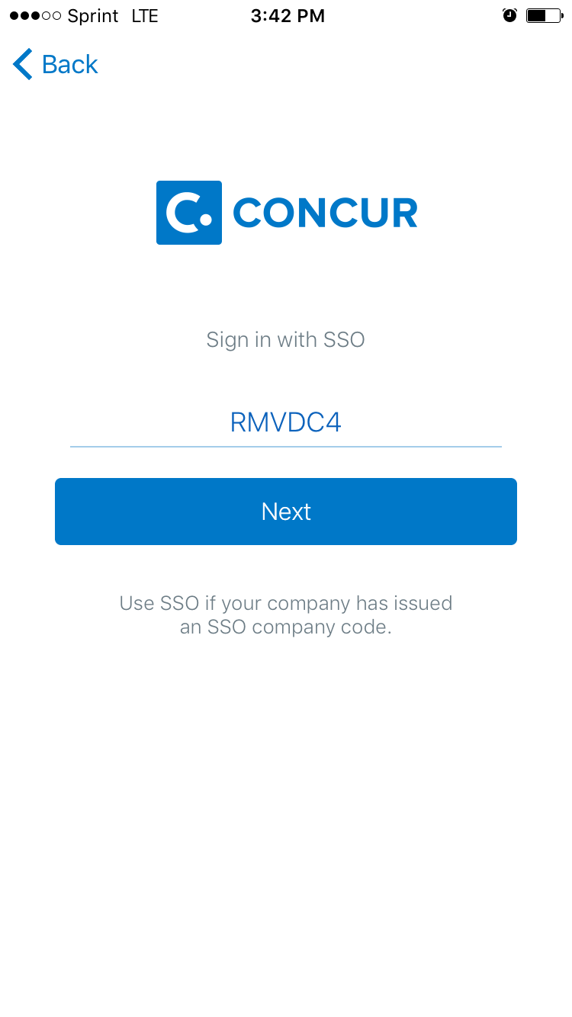
Enter RMVDC4 and click Next

Slide 4
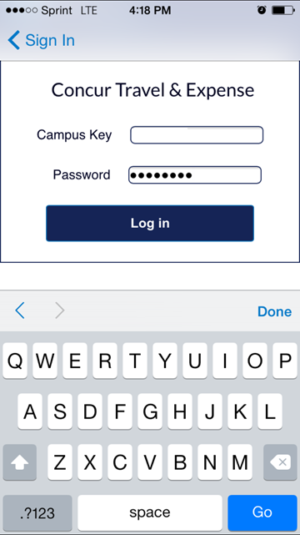
Enter your campus key and password
Click Log In

Slide 5
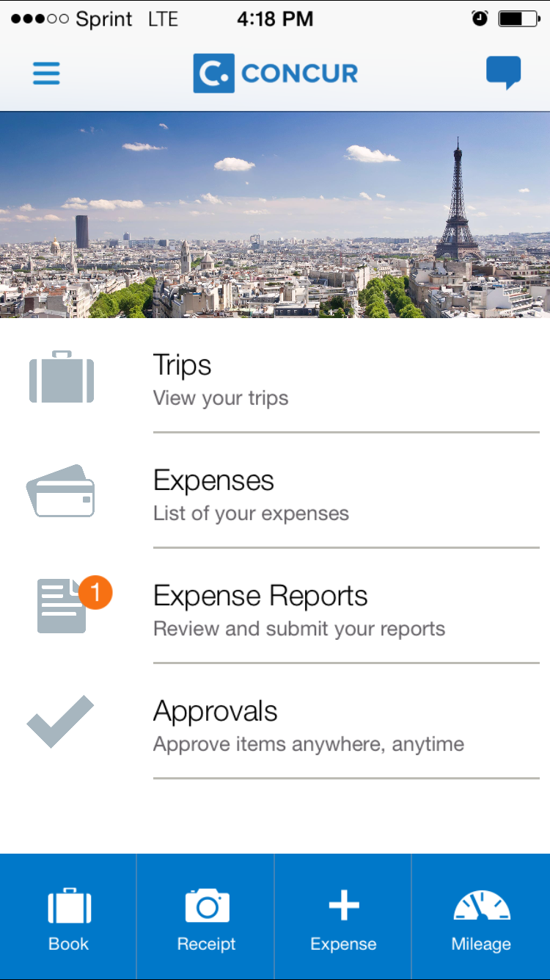
Click + Expense

Slide 6
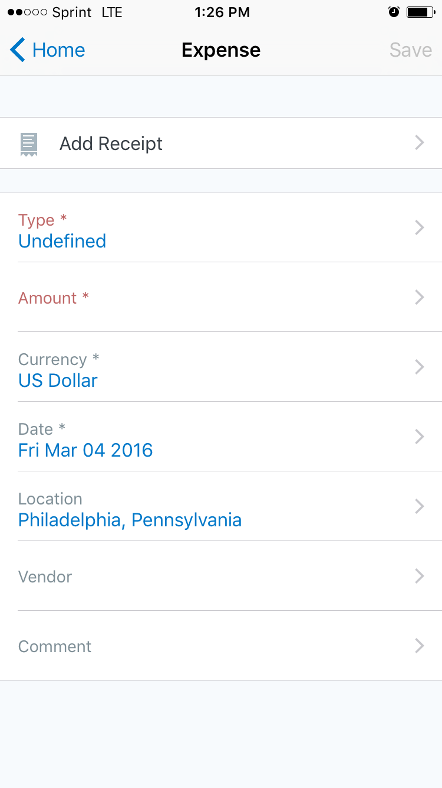
Click Add Receipt

Slide 7
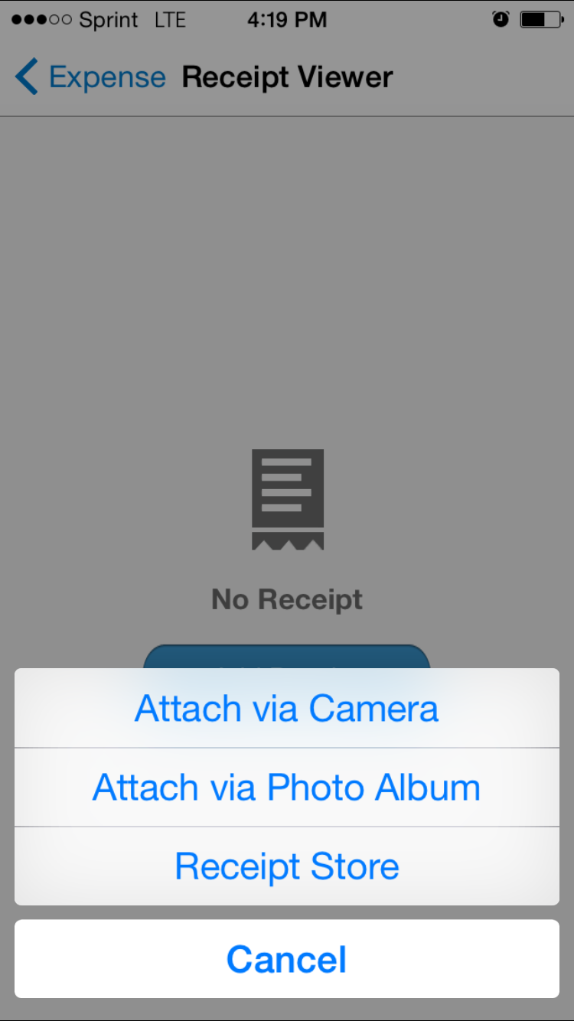
Click Attach via Camera (or Attach via Photo Album if you previously saved a receipt image)

Slide 8
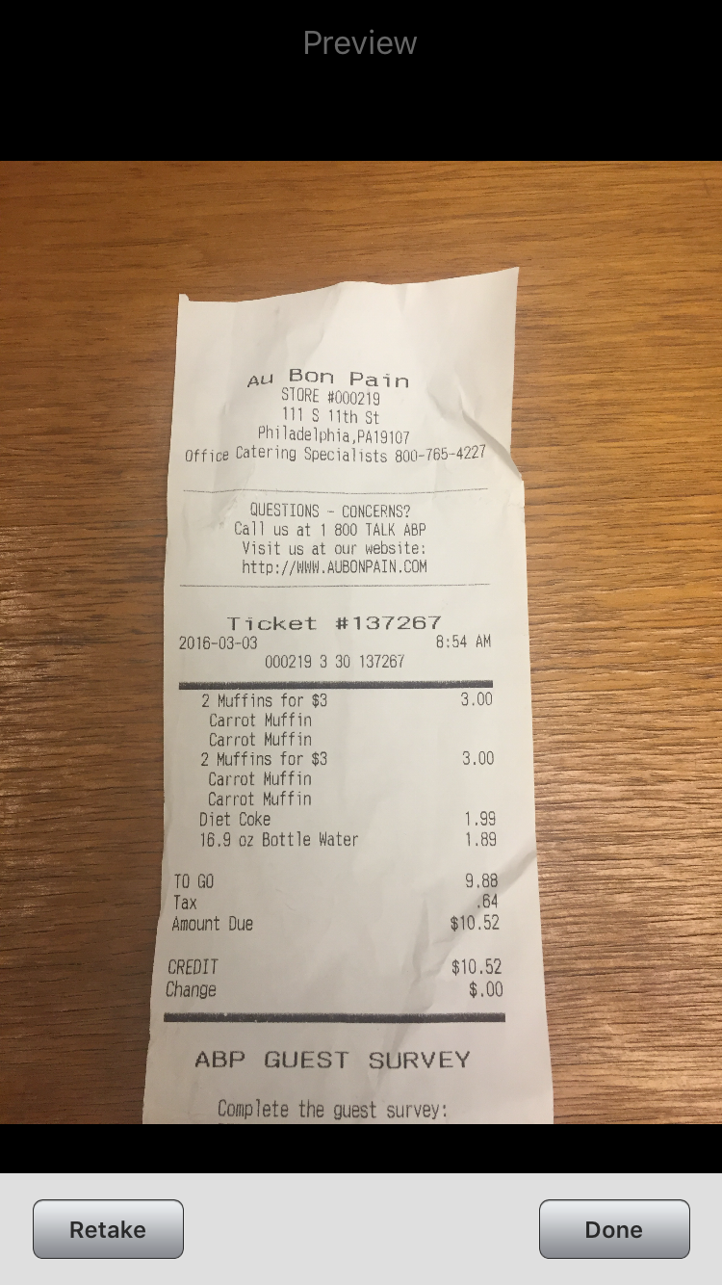
Hover over receipt image, being sure that vendor name, date, amount and any other pertinent details are in frame and in focus
Click Done

Slide 9
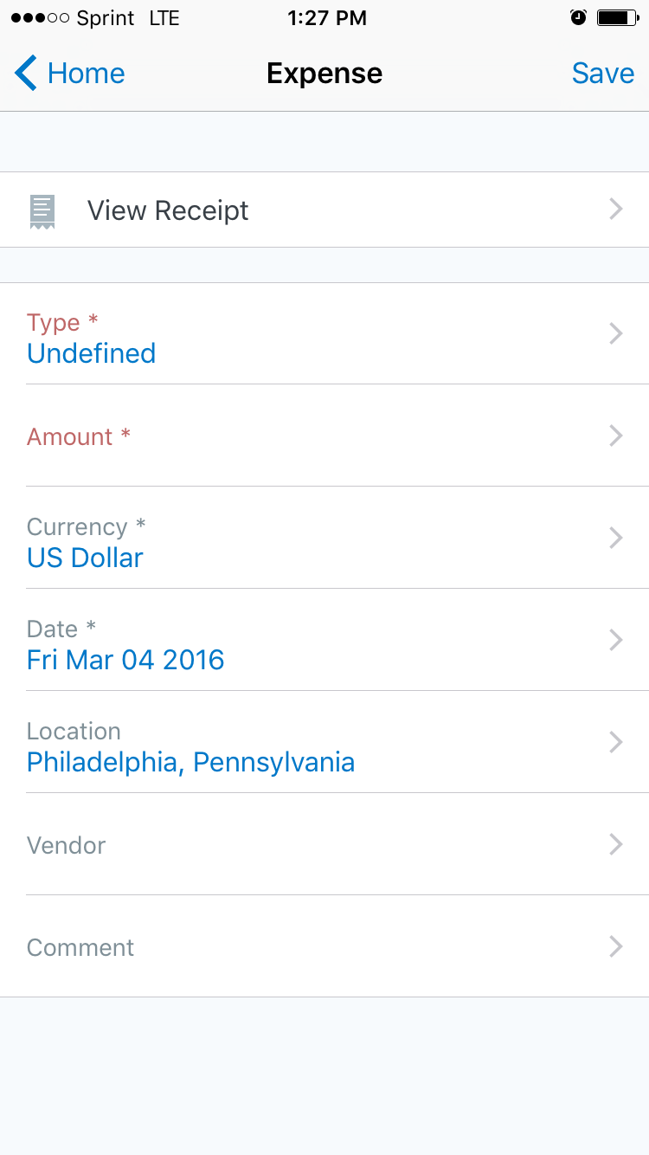
Select the appropriate expense type
Enter the amount of the expense
The date will default to the date of use. If you are entering an expense that was previously incurred, please enter the correct date

Slide 10
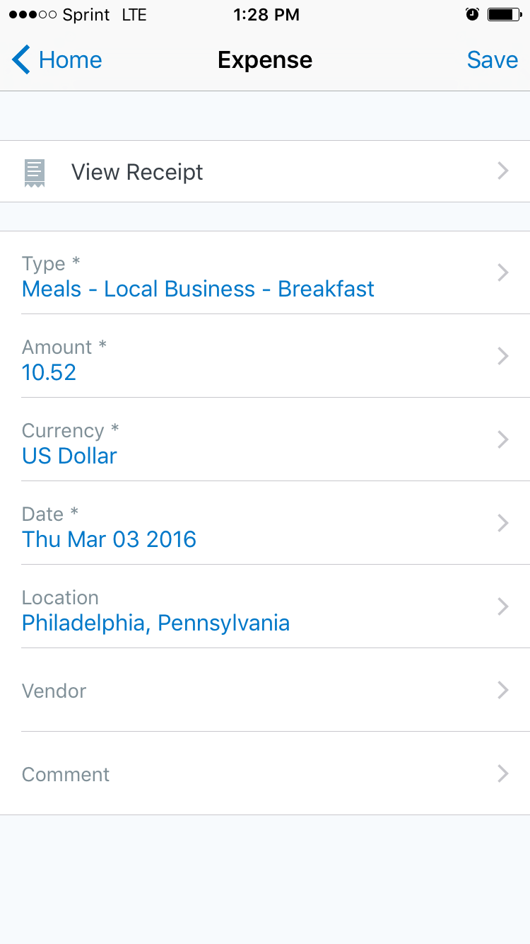
Verify Information
Click Save

Slide 11
Upon saving an expense, you will be redirected to a list of your open expenses

Slide 12
Select the expense(s) you wish to reconcile and click Add to Report

Slide 13
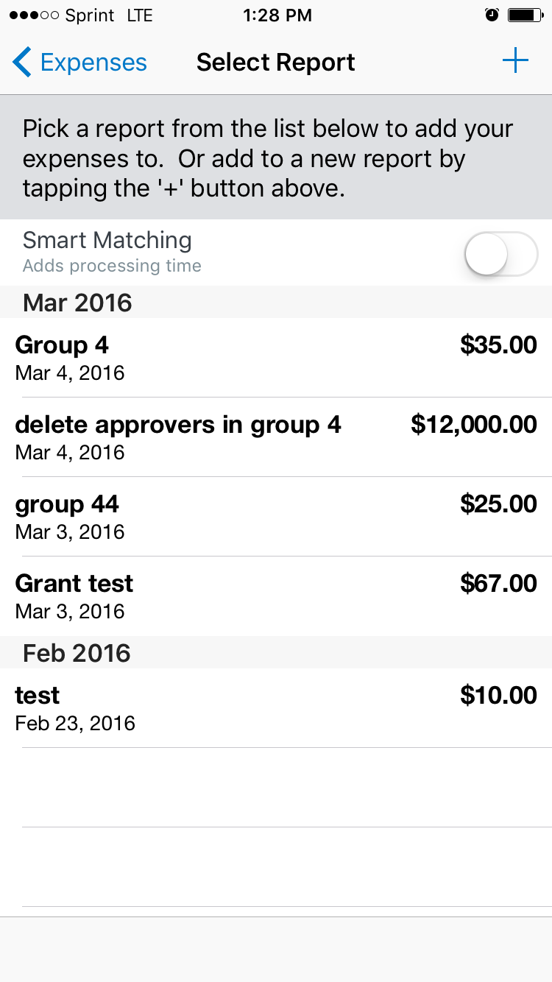
You may create a new report by clicking + or you may add the expenses to an open report by selecting it from the list

Slide 14
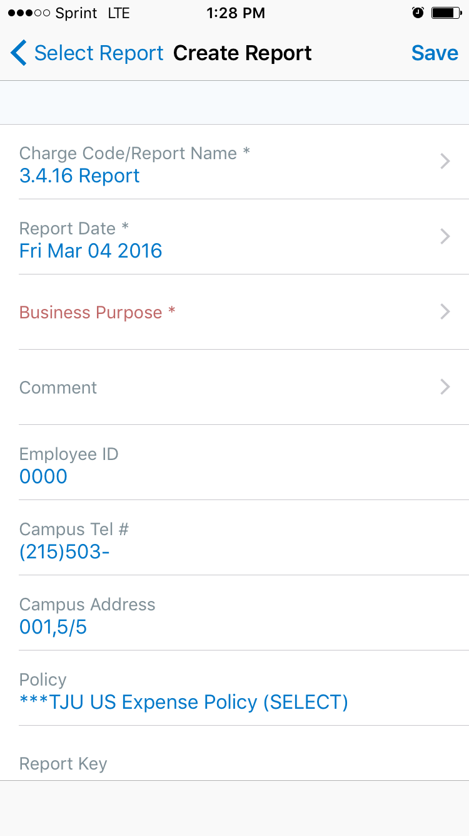
If you choose to create a new report, fill in the report header information and click Save

Slide 15
